Slide 1
Generating Sales in the Business Market
Business Owner & Executive Solutions
Sherry Flint, CLU®
Regional Vice President – Life

Slide 2
Agenda
Overview of the Business
Market
Identify the Right Clients
Support, Tools & Resources
Next Steps

Slide 3
Small Business Means BIG Business
More than 28 million small businesses¹
99.7% of U.S. firms have fewer than 500 employees²
19% of family business participants have not completed any planning other than writing a will – and only 36% have an exit plan.³
At any given time, 40% of businesses are wrestling with transfer of ownership and control.⁴
Over the next 20 years, $4.8 trillion of net worth will be transferred.⁴
For more than 60 years, The Principal has focused on serving the needs, challenges and opportunities faced by business owners and executives.
1. U.S. Small Business Administration Office of Advocacy, Frequently Asked Questions, March 2014. 2. SBA office of advocacy: www.sba.gov 3. Family Firm Institute: www.ffi.org, 4. Family Firm Institute, 2009
For Producer Information Only. Not For Use In Sales Situations.

Slide 4
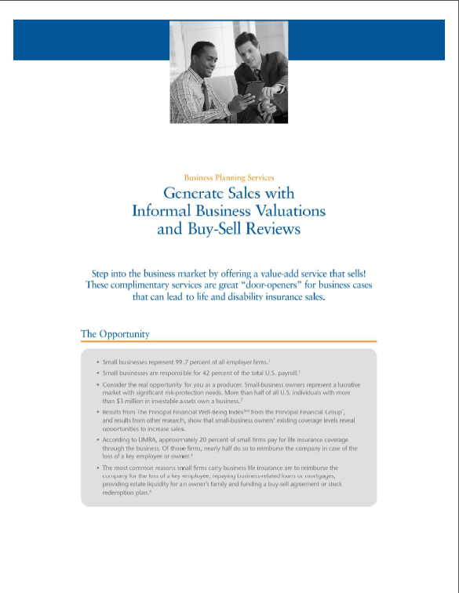
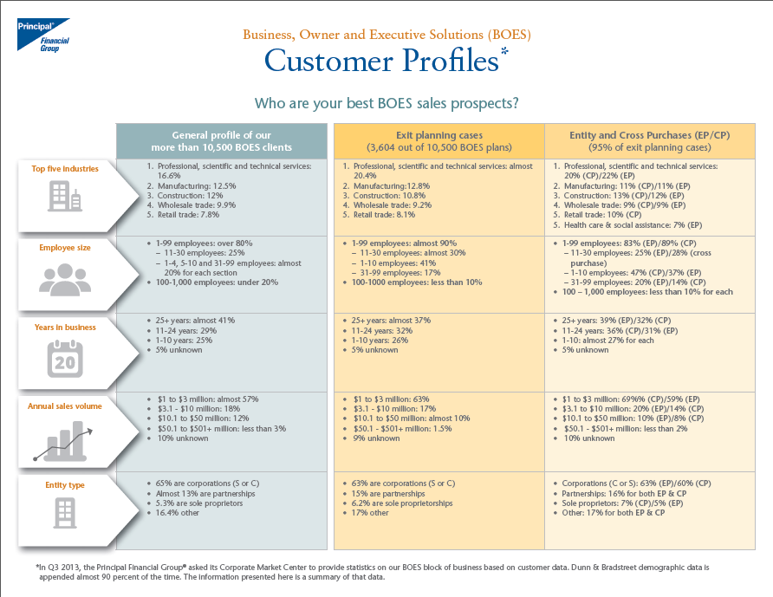
Ideal Prospects
BOES Profile
Top Industries in 2016
Ideal Prospects:
Established Businesses
$1MM – $10MM Annual Revenue
1 – 30 Employees
Professional, Scientific, Technical Services
Manufacturing & Construction
Most prevalent entity type is Corporation (S or C)
Over 40% of plans are sold to companies with more than 25 years in business
67% of BOES clients have less than 30 employees
Supporting Documents
BOES Customer Profiles
Generate Sales with Buy/Sell Reviews
Notes:
Once you pinpoint the value-add you will bring to the organization, your next focus will be to ask questions around their processes... You’ll want to understand both the sales and service side of the P&C operation, then think about how to integrate your solutions into their processes.
One of the best ways to build trust within an organization is to engage in activities that allow you to become part of the team. Whether you’re housed in their offices, or not – you should find ways to share you expertise with both sales and service staff, provide them with simple approach tools to introduce the new offering they will make available, and attend their sales and service meetings – at least quarterly.
Ideas to build trust and become part of the team – Offer:
Value-added services/Expertise
Simple approach tools (checklists/ calculators)
Attend sales meetings
Present lunch & learns
Co-host Client Briefings/Appreciation Events
Handout to use: BB11771 and BB11774

Slide 5


Slide 6
BOES platform offers a complete package to give you an edge:
The Principal® Difference
Value-Added Tools
Technical Expertise
Customized Proposals with Recommendations
Business Focused Products
Underwriting
Advanced Sales Expertise
Administrative Services
Everything you need in one place.

Slide 7
Advanced Solutions
BOES: Your Team, Your Resources
Over 200 years experience
Credentials employed: JD*, CPA*, CLU, ChFC, CFP®, MBA
Expertise in:
Executive benefits
Exit/succession strategies
Estate planning
Financing options & product fit
For more than 60 years, The Principal has focused on serving the needs, challenges and opportunities faced by business owners and executives.
Our purpose:
Experienced sales support
Personalized consulting
Our people:
Attorneys
CPAs, MBAs
BOES Wholesalers
Case design specialists
*JD is an educational degree and holder does not provide legal services on behalf of the companies of the Principal Financial Group®.
*CPA does not provide tax or accounting services on behalf of the companies of the Principal Financial Group®.
For Producer Information Only. Not For Use In Sales Situations.

Slide 8
Average BOES Case
 | Average Policies Per Case | Average Premium Per Policy | Average Premium Per Case
Buy/Sell | 2.5 | $5,304 | $13,261
Key Person | 1.9 | $4,384 | $8,331
Executive Bonus | 5.0 | $5,930 | $29,429
S-Owner/LLC Bonus | 1.9 | $12,819 | $24,357
Select Reward Plan | 8.9 | $8,630 | $76,804
Source: January 2015 – December 2016 Principal Life Insurance Company
For Producer Information Only. Not For Use In Sales Situations.

Slide 9


Opening Cases with Business Planning Services
Successful Approaches
Approaching business owners made easy
Informal business valuation
Review of major provisions of the buy-sell/funding
Start discussions with tax and legal advisors
Identify issues and confirm the agreement meets current objectives
Business planning services opens the door to planning opportunities!
Start with the Business Planning Services Fact Finder to uncover needs.
Then use the Business Priorities Checklist to help prioritize needs.
For Producer Information Only. Not For Use In Sales Situations.

Slide 10
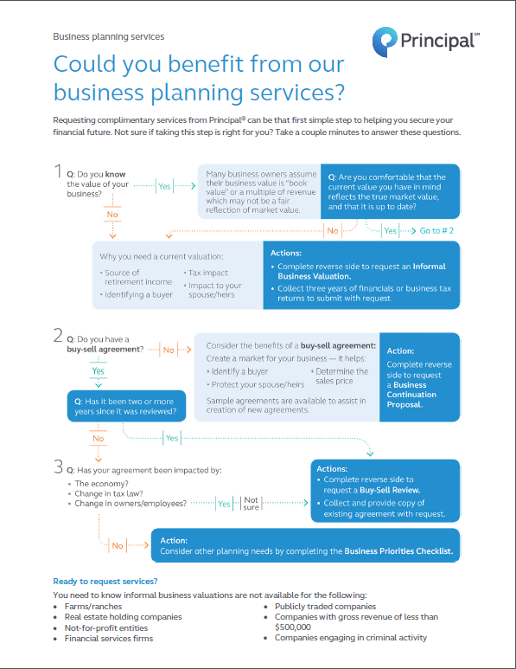
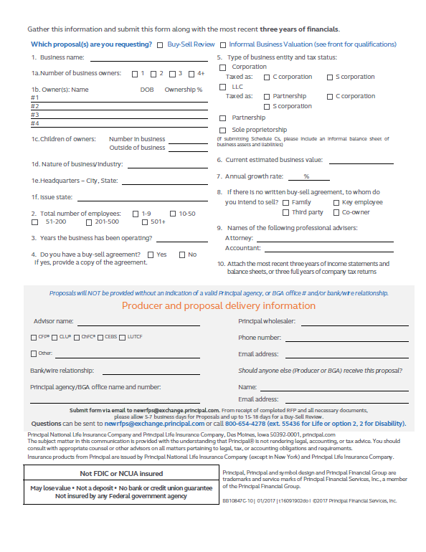
Ask the right questions with the Business Planning Services Fact Finder
Business Planning Services
For Producer Information Only. Not For Use In Sales Situations.

Slide 11

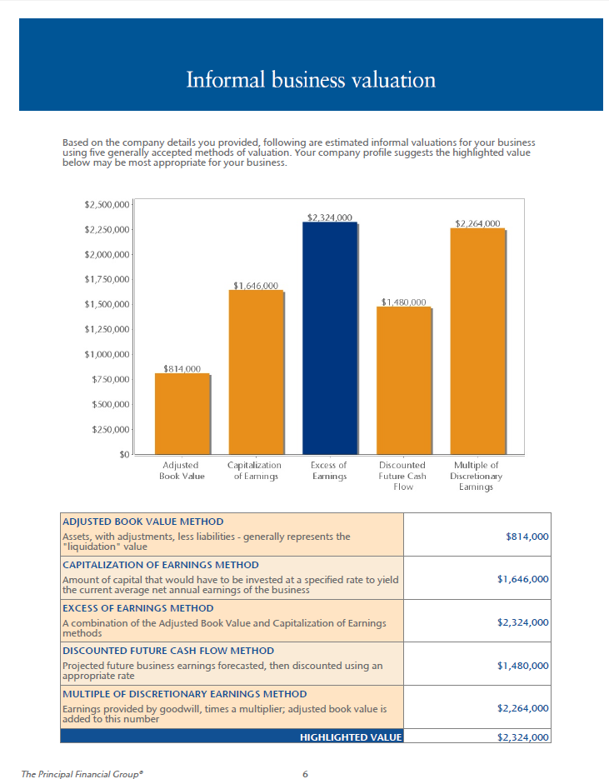
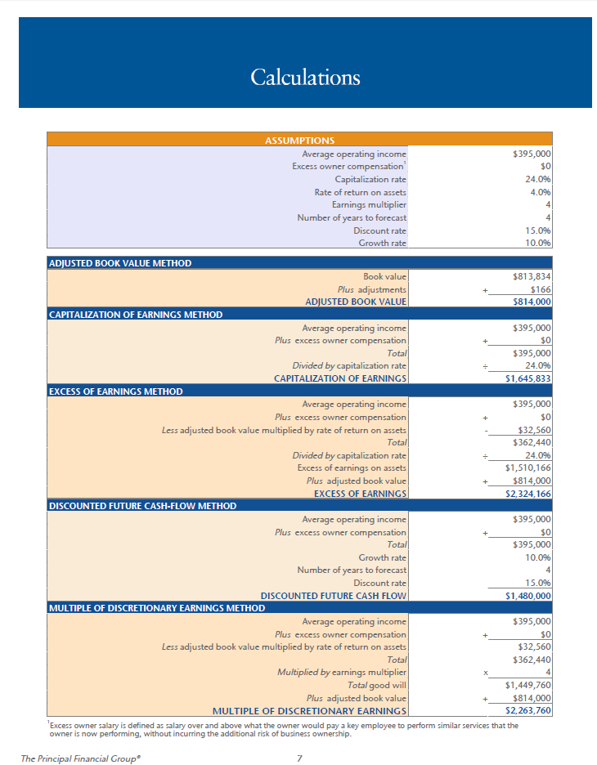
Converting Profits to Wealth
For Producer Information Only. Not For Use In Sales Situations.

Slide 12
Good Prospects
Business Valuation: Who to Approach
Manufacturing companies
Construction companies
Professional service-related companies:
Architects
Healthcare systems
Law firms
Dental
Engineering firms
Accounting firms
Information technology companies
Profitable, growing businesses
Gross revenues of $1m and above
For Producer Information Only. Not For Use In Sales Situations.

Slide 13
Challenging Prospects
Business Valuation: Who to Approach
Farms & Ranches
Non-profit organizations
Non-profitable businesses
Publicly traded companies
Sole proprietors
Real estate holding companies
Financial services firms
New companies
For Producer Information Only. Not For Use In Sales Situations.

Slide 14
Business Owner & Executive Solutions: Planning Opportunities

Slide 15
Top Three Industries
Exit Planning Profiles
Professional, scientific, technical services
Law/CPA Firms
Construction
Manufacturing
Remember that two of three family-owned businesses
have no exit plan in place.
For Producer Information Only. Not For Use In Sales Situations.

Slide 16
What happens if…
Buy-Sell Challenges
The relationship between owners sours?
An owner dies?
An owner becomes disabled?
Keep in mind these additional “triggers”
For Producer Information Only. Not For Use In Sales Situations.

Slide 17
Common Triggering Events
Death
Disability
Divorce
Bankruptcy
Termination
Retirement
For Producer Information Only. Not For Use In Sales Situations.

Slide 18
Common pitfalls:
Buy-Sell Challenges
No formal agreement – think family-owned businesses
Poorly structured agreement
No funding
Antiquated agreements
For Producer Information Only. Not For Use In Sales Situations.

Slide 19

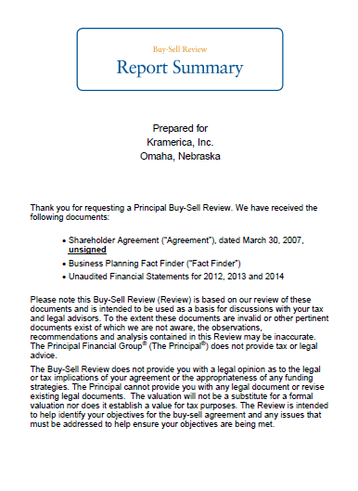
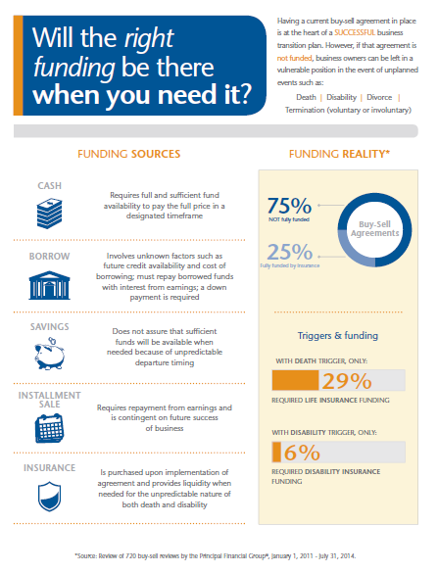
Buy-Sell Review or Business Continuation Plan
Request a complimentary buy-sell review
Implement a business continuation plan

Slide 20
Business Owner & Executive Solutions: Planning Opportunities

Slide 21
Top Three Industries
Key Person Profiles
Professional, scientific, technical services
Law/CPA firms
Engineering
Architecture
Medical Practices
Construction
Manufacturing
38% of companies have less than 10 employees
For Producer Information Only. Not For Use In Sales Situations.

Slide 22
Who is the difference maker in your company?
Business Protection
Immediately change operations, customer relations, profitability
Significant recovery time
“Who is the last person you’d want to get a resignation letter from tomorrow morning?”
For Producer Information Only. Not For Use In Sales Situations.

Slide 23

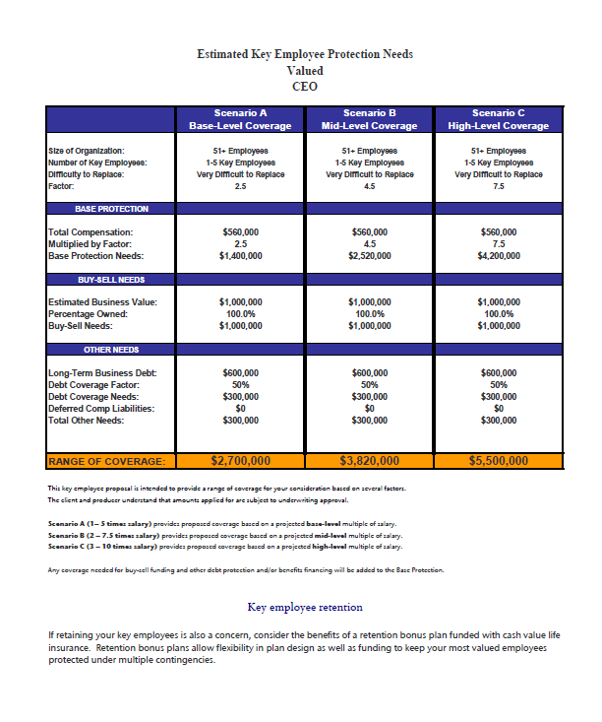

Key Person Customized Proposal
Business Protection
For Producer Information Only. Not For Use In Sales Situations.

Slide 24
Business Owner & Executive Solutions: Planning Opportunities

Slide 25
Supplemental Owner Retirement Plan
“I’m more concerned about me.”

Slide 26
Challenges a business owner faces
Business Owner Retirement
Taking care of themselves vs. their employees
The “traditional” retirement gap
Converting the business value into retirement value

Slide 27

Business Owner Retirement Analysis

Slide 28
Business Owner Retirement Analysis
Owner Strategies
Determining an income goal
Valuing the business
Identifying the gaps
Creating a transition plan

Slide 29
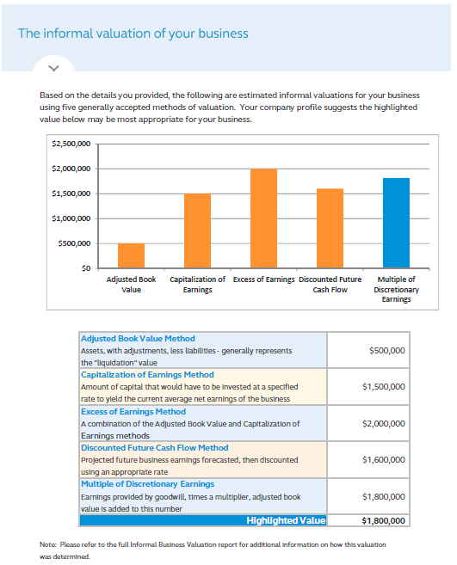
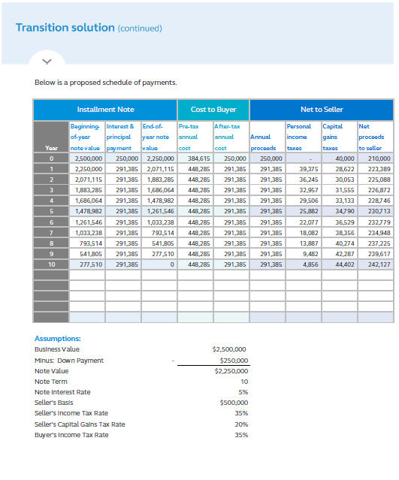
Business Owner Retirement Analysis
Owner Strategies

Slide 30
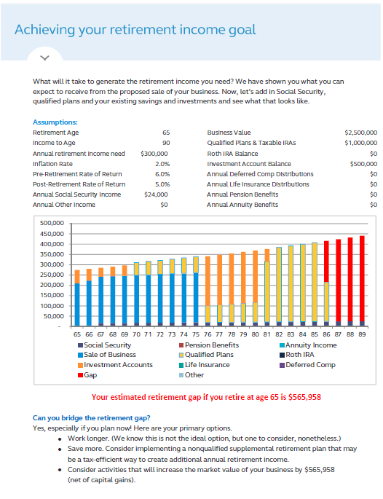
Business Owner Retirement Analysis
Owner Strategies

Slide 31
Top three non qualified plan sales!
Retirement Income
Retirement savings for the owner
Recruiting, rewarding and retaining key employees
Creating a succession plan to a key employee

Slide 32
Non-Qualified Planning Solutions
Bonus Plans
Simplified Deferred Compensation Plans
Full-Service Deferred Compensation Plans
Principal S-Owner PlusSM
Principal LLC BonusSM
Principal Executive Bonus PlusSM
Principal SERP SelectSM
Principal Select Reward PlanSM
Executive Nonqualified “Excess” PlanSM
Executive Nonqualified Defined Benefit PlanSM

Slide 33
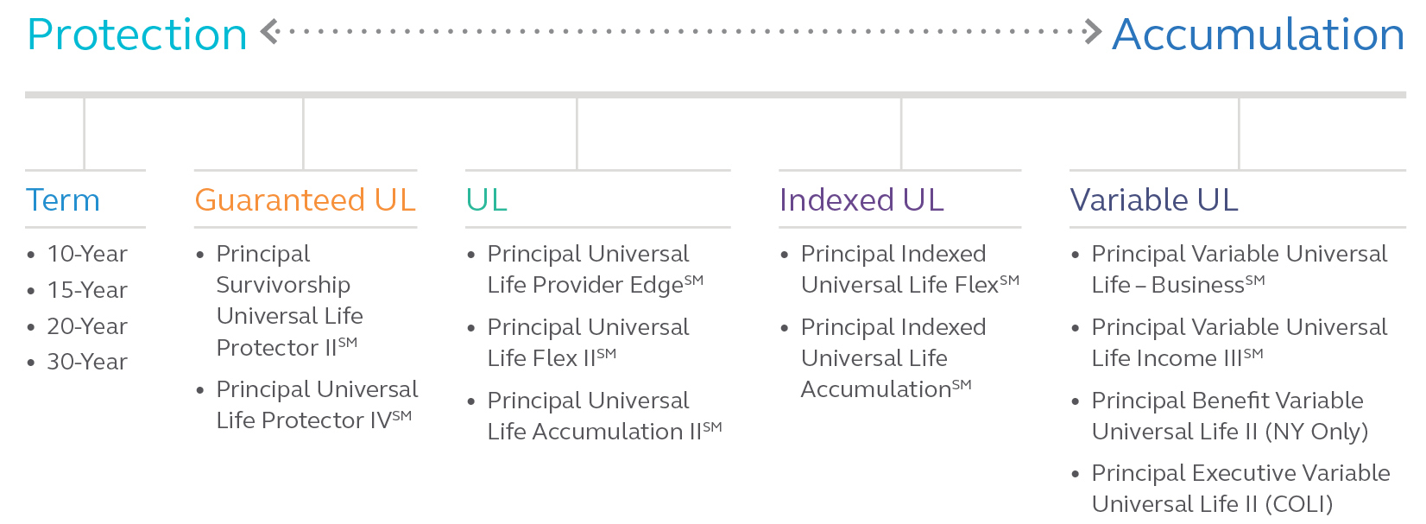
A balanced portfolio
For financial professional information only. Not for use with the public.
Notes:
The time is right. Accumulation-focused IUL sales accounted for 42 percent of all UL premium in the first quarter 2016. (LIMRA 1st Quarter Sales Report)
AG 49 introduced:
Standardized approach for maximum illustrated rates
100 bps. maximum spread for non-fixed loans
Alternative scale ledger
Historical percentiles
We have an accumulation product for any risk tolerance level – UL, VUL and now IUL. This product does not replace IUL Flex. IUL Flex is designed for affordable protection with moderate premium funding levels.

Slide 34
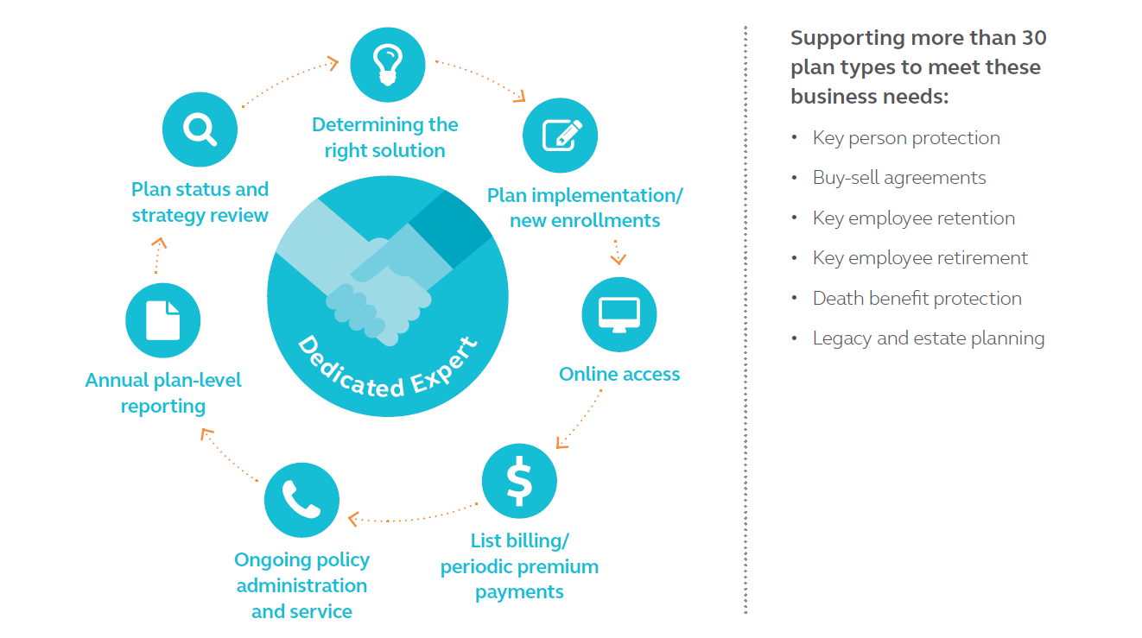
Exceptional service every step of the way
Business Markets Administration
For Producer Information Only. Not For Use In Sales Situations.

Slide 35
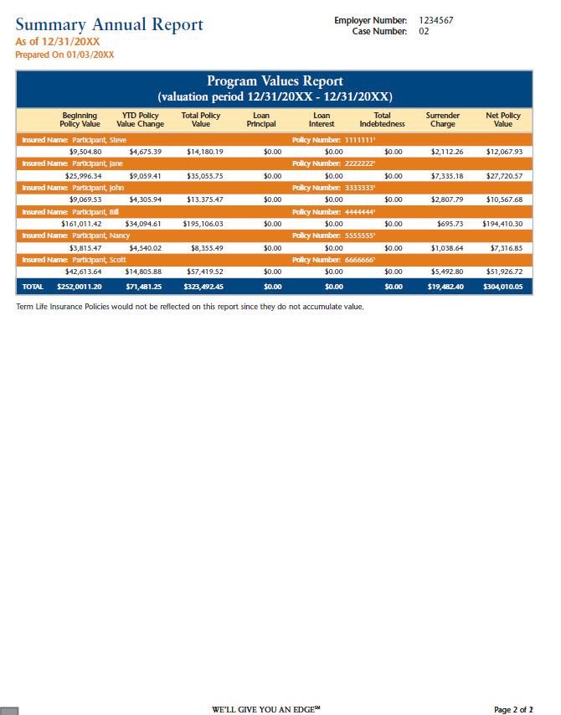
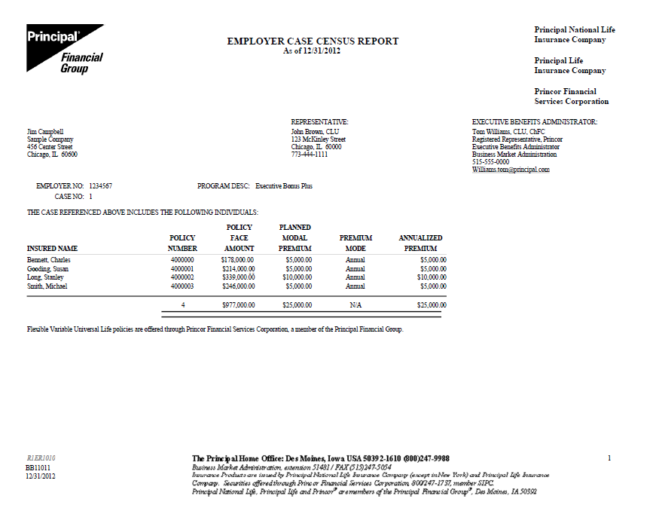
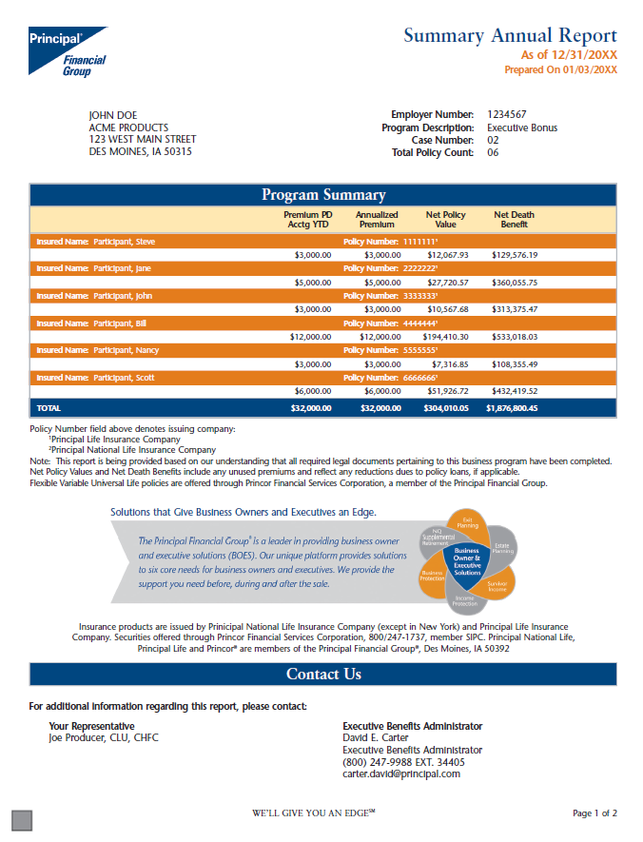
Sample Reports

Slide 36
Underwriting Programs: Write Business Faster
®

Slide 37
Healthy Life Style Credits (HLCs)
Traditional Underwriting
Available on all products, any face amount, ages 20-85
Excluded: Non-medical ratings, diabetes, BNP, MAQ, CVA, CAD, atherosclerotic disease, lifestyle (drugs, alcohol)
Can be used on ratings if flat extra is $5/k or less*
Utilized when we have a knock-out (build, blood pressure/lipids) for a Preferred class to improve

Slide 38
Automatic Standard Approval Program
Traditional Underwriting – Table Shave
Up to $5M face amount
Max age 70
Up to Table 3 or Flat Extra $7.50/$1,000
Permanent products only – Both lives on SUL
Medical ratings only

Slide 39
Multi-Life Underwriting Programs
Minimum # of lives: Simplified Issue – 5 / Guaranteed Issue – 10
Ages 18-70; Average age <55
Income > $75k W-2 compensation
Multiplier approach: 10 lives X $25k = $250k max face
Minimum face: $100k / Maximum face: $5M
Permanent products only
Mix and match products and concepts

Slide 40

Accelerated Underwriting
Ages 18 – 60
Maximum Face Amount: $1,000,000
All Products: Term, UL, IUL, VUL & SUL
Preferred/Super Preferred
Predictive Analytics
TeleApp, MVR, MIB & Rx Check
Offers within 48 hours
10 days from app to issue
Fully commissionable

Slide 41
Case Study
Informal Business Valuation Case Study

Slide 42
Facts about the business
Business Planning Services: Case Study
Construction management firm specializing in commercial building
12 years in business
Husband & wife owners
35 employees
S- Corporation
For Producer Information Only. Not For Use In Sales Situations.

Slide 43
Key Issues
Business Continuation – What happens if either spouse dies?
Risk of losing the Women Owned Business status
Loss of key employee’s financial impact on the firm

Slide 44
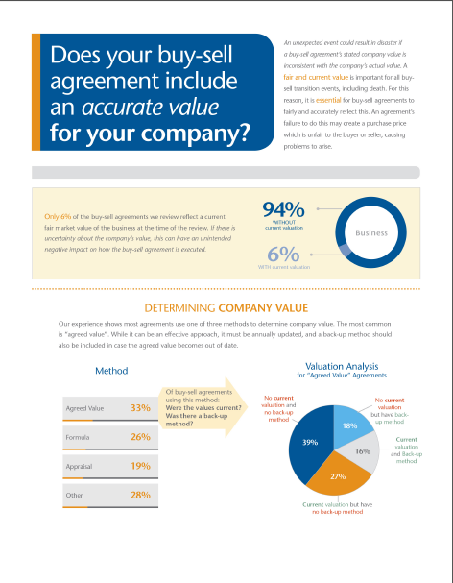
How was the client approached?
Business Planning Services: Case Study
For Producer Information Only. Not For Use In Sales Situations.

Slide 45
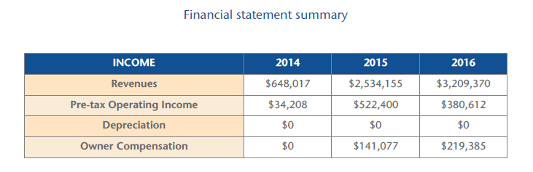
Business Financials Overview
Business Planning Services: Case Study
For Producer Information Only. Not For Use In Sales Situations.

Slide 46
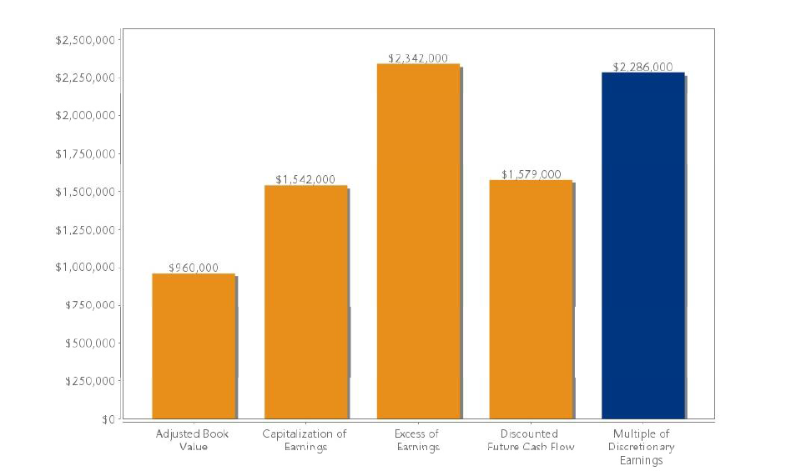
Valuation Results
Business Planning Services: Case Study
For Producer Information Only. Not For Use In Sales Situations.

Slide 47
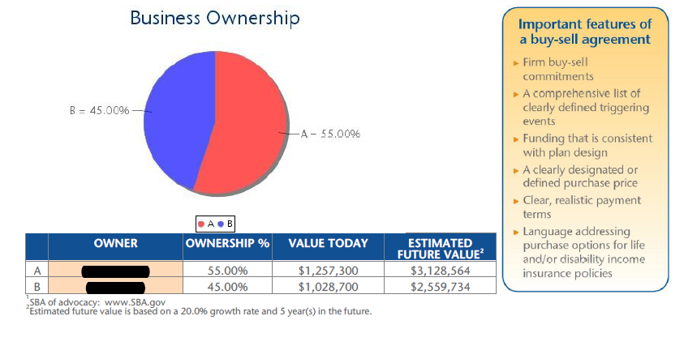
Planning Opportunity #1: The Buy-Sell
Business Planning Services: Case Study
For Producer Information Only. Not For Use In Sales Situations.

Slide 48
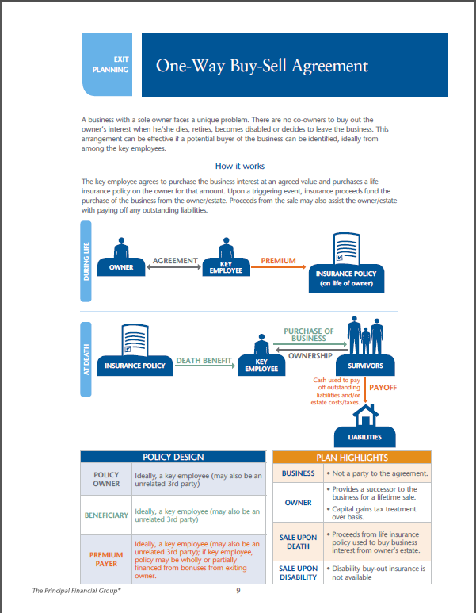
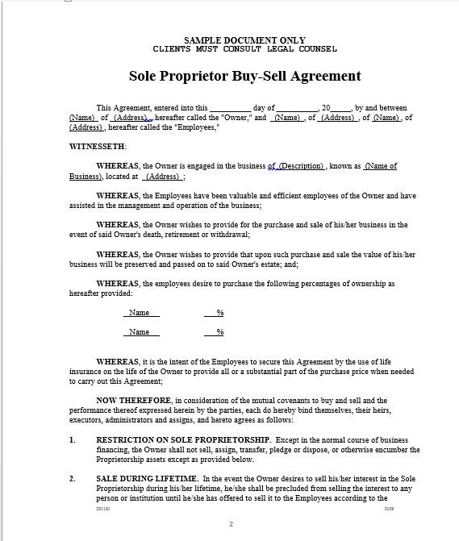
Planning Opportunity #1: The Buy-Sell
Business Planning Services: Case Study

Slide 49
Planning Opportunity #1: The Buy-Sell
Business Planning Services: Case Study
Limited to buy-sell funding equal to ownership
Stacking key person coverage fulfills obligation
Husband’s
Total Need
$2.3M
Key Person
(Salary $210k)
$2.1M
One Way
Buy-Sell
$1.03M

Slide 50
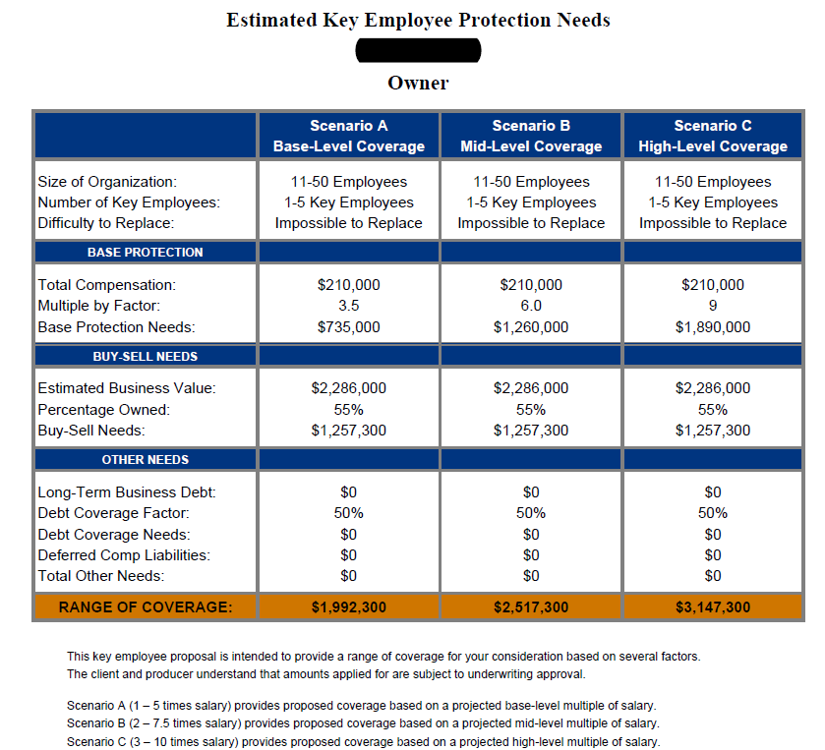
Planning Opportunity #2: WOB Loss
Business Planning Services: Case Study
A significant portion of contracts tied to Women Owned Business status

Slide 51
Planning Opportunity #3: Key Person
Business Planning Services: Case Study
Loss of key employee for death
Keeping him their key employee
Key Person Insurance
$2,000,000
Non-Qualified Plan

Slide 52
Total Plan Premiums
Proposed NQ Plan:
$50,000
Buy-Sell & Key Person:
$11,395
Total Premium: $61,395
For Producer Information Only. Not For Use In Sales Situations.

Slide 53
Sales Idea
The Power of Three

Slide 54
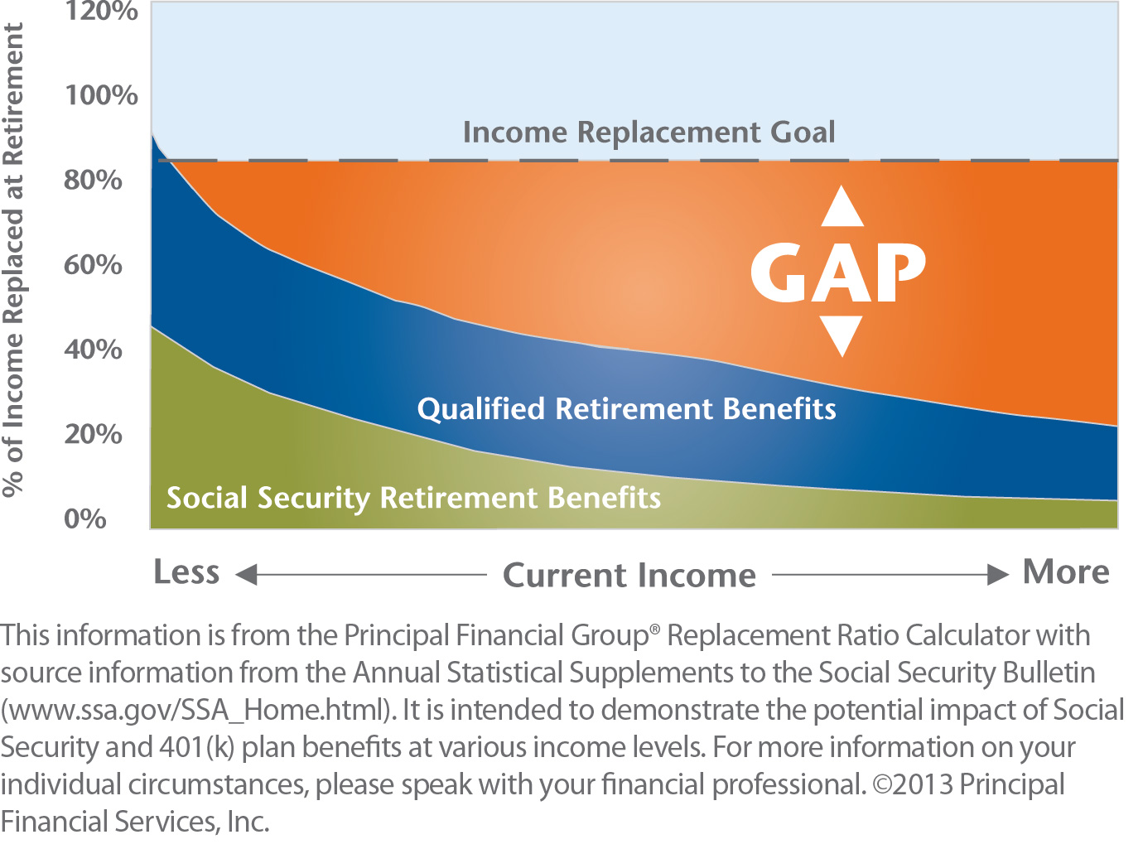
The Retirement Gap
For Producer Information Only. Not For Use In Sales Situations.

Slide 55
Who are buying Accumulation products?
Ideal prospects: Ages 35-55
Individuals falling into the retirement gap
Sole proprietors
Owners & Employees of top heavy qualified plans
Physicians & Dentists
CPA’s & Attorneys

Slide 56
The Power of Three

Slide 57
#1: Accelerated Underwriting
Ages 18 – 60
Maximum Face Amount: $1,000,000
All Products: Term, UL, IUL, VUL & SUL
Preferred/Super Preferred
Predictive Analytics
TeleApp, MVR, MIB & Rx Check
Offers within 48 hours
7.8 days from app to issue
Fully commissionable

Slide 58
#2: Pick an Accumulation Product
UL
IUL
VUL
Riders available:
High Early Cash Value Rider: SVER – available for business cases
Chronic Illness rider (CIDBAR) – available in many all states
For financial professional information only. Not for use with the public.
Notes:
A persistency credit rewards long-term policy ownership.

Slide 59
#3: Automated Features
EASY | Complete a single form to receive automated income as frequently as monthly.
EFFICIENT | Death benefit option automatically switches from increasing to level when distributions begin. Surrenders automatically flip to loans when cost basis has been exhausted. Distribution amount re-calculates annually to ensure target-ending cash value goal is met.
ENDS PROPERLY | Automated over-loan protection converts the policy to a reduced paid-up status when qualifying conditions are met, protecting against policy lapse and potential tax liability.

Slide 60
A Solution in 3 Easy Steps
Life Insurance Retirement Plan
No funding limitations
Asset diversification strategy
Tax diversification strategy
Income diversification strategy

Slide 61
Getting Started
Capmar and Principal Support
Developing CI’s
Webinars
Conference calls
Business Owner seminars
BOES Team
Advanced Solutions team – attorney’s and CPA’s
Sherry Flint, CLU®
RVP– Life Distribution
C: 858-883-5410

Slide 62

Agenda
The Columbus Life Difference
Technology to Accelerate
Your Business
Enhancements for 2017
Columbus Life Rewards
Notes:
Read slide

Slide 63


Columbus Life’s Product Portfolio
5 Differentiators of
Ward Carson
Regional Vice President
COLUMBUS LIFE INSURANCE COMPANY
For financial professional use only. Not for use with public
Slide 63 of 45 CLFD5.153 (03/16)
Columbus Life Insurance Company, Cincinnati, Ohio is licensed in the District of Columbia & all states except New York.
Notes:
64288277
Good Morning / Afternoon and thank you for taking time out of your busy day to join us for today’s Columbus Life Webinar, where we will review some off our competitive advantages and talk about unleashing the potential of CLICs product portfolio.

Slide 64


Discover: Superior Strength
Financial Strength
A+
A.M. Best
In Comparison…
(second highest of 16 ratings)
80of 100
91of 100
A.M. Best: A+ Superior, Superior ability to meet ongoing insurance obligations (second highest of 16 ratings; rating held since June 2009)
SUPERIOR
AA
Standard & Poor’s
Industry Average Comdex Ranking
Average of 25 Largest Companies Comdex Ranking
(third highest of 21 ratings)
Standard & Poor’s: AA Very Strong, Very strong financial security characteristics (third highest of 21 ratings; rating held since July 2013)
VERY STRONG
AA
Fitch
(third highest of 21 ratings)
Fitch: AA Very Strong, Very strong capacity to meet policyholder and contract obligations on a timely basis (third highest of 21 ratings; rating held since June 2009)
VERY STRONG
96
out of 100
Comdex* Ranking
Comdex Ranking: 96 out of 100, The Comdex Ranking is a composite of all the ratings a company has received from the major rating agencies. It ranks insurers on a scale of 1 to 100 (where 1 is the lowest) in an effort to reduce confusion over ratings because each rating agency uses a different scale.
Ratings are subject to change from time to time. The ratings shown here are correct as of 6/15/16.
Notes:
Across the board, we receive exceptional ratings from the various rating agencies, leading to an overall Comdex Ranking of 96.
In comparison the Average Comdex ranking for the 25 largest companies is 91 our of 100, and the industry average is 80.
It’s not just about rankings and numbers, though. It’s about helping to give your clients the peace of mind that Columbus Life can and will keep the commitments we make in our policies.

Slide 65


A Proud Member of the
Western & Southern Financial Group
One of the financially
STRONGEST
Life Insurance Groups
In the World
Notes:
Strength matters. And it shouldn’t just matter to policy holders, but also to producers, because the strength of the life insurance carrier impacts the ability of that carrier to build and maintain strong relationships with the agents contracted to sell their products, and keep the commitments they’ve made to policyholders and producers alike. The last few years of volatility and uncertainty in the economy has certainly impacted the value consumers place in the strength of the company they are buying a financial product from. Marketing departments recognize this as well, and if you look at the promotional materials of many life insurance companies on the market, regardless of the company’s financial ratings or history, there may be a section touting the financial strength of the company. And, at the end of the day, the financial ratings and balance sheets of the company tell the true story of how “strong” a company really is.
Columbus Life is a proud member of the Western & Southern Financial Group. Western & Southern is one of the financially strongest life insurance groups worldwide, providing strength and support that enhances the value Columbus Life can offer to producers and clients alike.

Slide 66

PRODUCT PORTFOLIO
simple | practical | competitive
Life
Annuities
No Lapse Guarantee UL Cash Accumulation UL Indexed UL Second to Die UL
Term
Life Plus Accelerated Death Benefit Rider
Capital Transfer rider
+ more…
Single Premium Immediate
Fixed
Indexed
Listed products and features may not be available in every state. Provisions of each product may also vary by state.
Notes:
Over time, we have carefully built up a consistent, competitive portfolio of products that you can offer your clients. We have also recently added and enhanced our product portfolio to provide your clients with flexible products. Columbus Life is primarily a universal life carrier, with individual and joint-life options that focus on everything from death benefit to cash value accumulation. Our Nautical Term is known for its competitive pricing paired with access to a return of premium rider and flexible conversion privileges. For those in the annuity market, we offer three varieties of fixed, single-premium deferred annuities, and one SPIA with many distribution options along with our new Fixed Indexed Annuity. Lets first look at the strong income potential of our IUL product the Indexed Explorer Plus and it’s index strategy.

Slide 67


Return of Premium (Term)
Life Plus Accelerated Death Benefit Rider
Capital Transfer (Enhanced NLG) (Death Benefit, Accumulation, ROP)
Overloan Protection
Enhanced Cash Value
Supplement Coverage (SCR)
Accidental Death Benefit
Disability Credit/Waiver of Premium
Insured Insurability
Change of Insured
Other Insured Term
Children’s Term + additional rider options
Columbus Life Policy Series: CL 83 0405, CL 83 0405 ID, CL 83-U 0405, CL 83-U 0405 ID, CL 85 0707, CL 85 0707 ID, ICC10 CL 87 1006, CL 87 1006, CL 88 0707, CL 88 0707 ID, CL 89 0806, CL 89 0806 ID, CL 90 0806, CL 90 0806 ID. Columbus Life Rider Series: CLR-135 0101, CLR-136 0608, CLR-137 0101, CLR-137 1208, CLR-143 0101, CLR-143 1208, CLR-179 1208, CLR-179 1308, CLR-201 1208, CLR-202 1409 and CLR-202 1409 CA.
Notes:
Alright so we have talked primarily about our products so far in the presentation lets switch gears to two of our most popular riders. Our Life Plus ADBR and our Capital Transfer rider. Columbus Life’s products can be customized with a variety of riders that you’ve come to expect from any carrier you do business with. However, we’ve developed a few riders that's features and flexibility help us stand out among the competition. Lets start with taking a quick look at our Life Plus Accelerated Death Benefit Rider and then we will comeback to the Capital Transfer Rider a little later in the presentation.

Slide 68
5 Differentiators
Index Strategy and Strong Income Potential of our Indexed Explorer Plus®
Competitive Guaranteed Universal Life
Advantage Fixed Indexed Annuities Goldman Sachs Strategy and Income Potential
Flexible Living Benefits of LifePlus® Rider
Capital Transfer Program
Notes:
Read 5 differentiators

Slide 69

a dedication to
simple effective
product design.
Notes:
We are dedicated to provide simple, effective common sense solutions to insurance needs. We offer products that your clients can understand, and as a result, are easier for you to sell. The guarantees we provide are outlined in clear language, and aren’t complicated by “shadow accounts” or complex calculations. Clients know, when purchasing a Columbus Life policy, what they are receiving and how it works. It’s a part of our culture, and how we do business.

Slide 70


Notes:
Our first differentiator is the Indexed Explorer Plus® UL which is an IUL that provides competitive indexing options without the added complexity that makes some IULs more difficult to understand. It offers 4 allocation options…

Slide 71


Indexed Explorer Plus®
UNIVERSAL LIFE
1 Year
1 Year
Over the declared Cap Rate
Return over the Threshold/
Spread Rate
1 Year
Earn up to the declared Cap Rate
Spread
Return once the Participation Rate is applied
1 Year
Earn up to the Threshold Rate
Fixed
4.7%
Fixed
Capped Annual Point-to-Point
Uncapped Monthly Average
Uncapped Annual
Point-to-Point with Spread
Notes:
Here you can see we offer one fixed account and 3 indexed accounts, 2 of which are uncapped.
Monies can be allocated into fixed, capped or uncapped indexed accounts. Monies in the fixed account can be moved into an indexed account prior to the start of any segment. Monies in an indexed account will remain in that segment for 12 months.
All three indexed account options use the S&P500 index. We have a annual point-to-point capped account, an uncapped annual point-to-point account that has a threshold rate of 7% and a spread of 5%, and an uncapped monthly averaging account.

Slide 72

Uncapped Annual Point-to-Point with Spread
Example 1: S&P has return of 20%
Example 1: S&P has return of 8%
Example 1: S&P has return of 6%
Index Explorer Plus Return = 15%
Index Explorer Plus Return = 7%
Index Explorer Plus Return = 6%
Company X Return = 15%
Company X Return = 3%
Company X Return = 1%
20%
18%
Return over the Threshold/
Spread Rate
16%
14%
12%
Spread
10%
Return over the Spread
8%
6%
Earn up to the Threshold Rate
4%
Spread
2%
Enhanced Index Explorer Plus
Company X
Notes:
Lets take a look at 3 hypothetical examples. (CLICK) Lets say we have Columbus Life’s Uncapped Annual Pt to Pt account with a 5% spread and 7% threshold rate and (CLICK) Company X who has a 5% spread rate starting at dollar 1. In EXAMPLE 1 (CLICK) there was a 20% return. (CLICK) With the Uncapped Annual pt to pt account with spread the client may receive 15% since you merely subtract the 5% spread from the S&P 500 return. With Company X the client could also receive a return of 15%.. (CLICK) In Example 2 there is a return of 8%. (CLICK) With our account the client may receive up to the 7% threshold rate and then Columbus Life would take the 1% spread. Now since Company X takes 5% at dollar one from the 8% that would leave the client with a 3% return. (CLICK) In our FINAL EXAMPLE the S&P 500 has a return of 6% and (CLICK) with our account the client may receive the full 6% since it is still within the threshold rate. Now since Company X takes 5% at dollar one from the 6% that would leave the client with a 1% return.

Slide 73
Uncapped Annual Point-to-Point with Spread
S&P 500 Return | Indexed Explorer Plus | Company X
20% | 15% | 15%
8% | 7% | 3%
6% | 6% | 1%
20%
18%
16%
14%
12%
10%
8%
6%
4%
2%
20% S&P Return
8% S&P Return
6% S&P Return
Notes:
So these examples illustrate that the Uncapped Annual pt to pt account with spread offers accumulation potential for when the S&P has conservative returns and for the handful of years when it has outstanding returns it is just as competitive as some of our top competitors.
We mentioned that the Uncapped Annual Point-to-Point was a unique index option let’s take a look at just how unique…

Slide 74






126 Indexed Life Products
47 Offer Annual Point-to-Point Strategies
with at least 100% Participation
8 Are Uncapped
1 Has Gains from the First Dollar
1
Source (as of 7/25/2016): Wink’s LifeSpecs tool, www.looktowink.com.
1 Because this indexed account includes a spread, the client would receive index interest credits from the first dollar, up to a defined Threshold Rate, and then a defined Index Spread Rate, is applied. There are no index interest credits earned within the Spread. The Threshold Rate and Index Spread Rate are set in advance. Competitor information is obtained from sources believed to be reliable; including other carriers’ illustration software, but its accuracy or completeness is not guaranteed. This data is for informational purposes and is not intended as a solicitation or recommendation of any insurance product. Premium rates and underwriting classes may vary by company. Calculations are based on internal research and evaluation.
Notes:
As of July 25th 2016, there were a total of 126 Indexed Universal Life products in the industry. (CLICK)
Of those 126 product offerings, only 47 companies offer IULs with S&P 500 Annual Point-to-Point Strategies with at least 100% participation. (CLICK)
Of that 47, only 8 offer all of this on an uncapped account. (CLICK)
In the end, there is only one carrier with a distinctly crafted indexed account option that can give your clients all of this and do it with gains from the first dollar — and that is (CLICK) Columbus Life.
Recently another carrier has added an IUL with an Uncapped S&P 500 Annual Pt-to-Pt Allocation Option with 100% participation rate but their spread begins at dollar one. We are still the only one who strategically places the spread above the threshold rate, allowing maximum growth potential for clients from first dollar.
Now let’s look at the income potential that is offered on the Indexed Explorer Plus through…

Slide 75
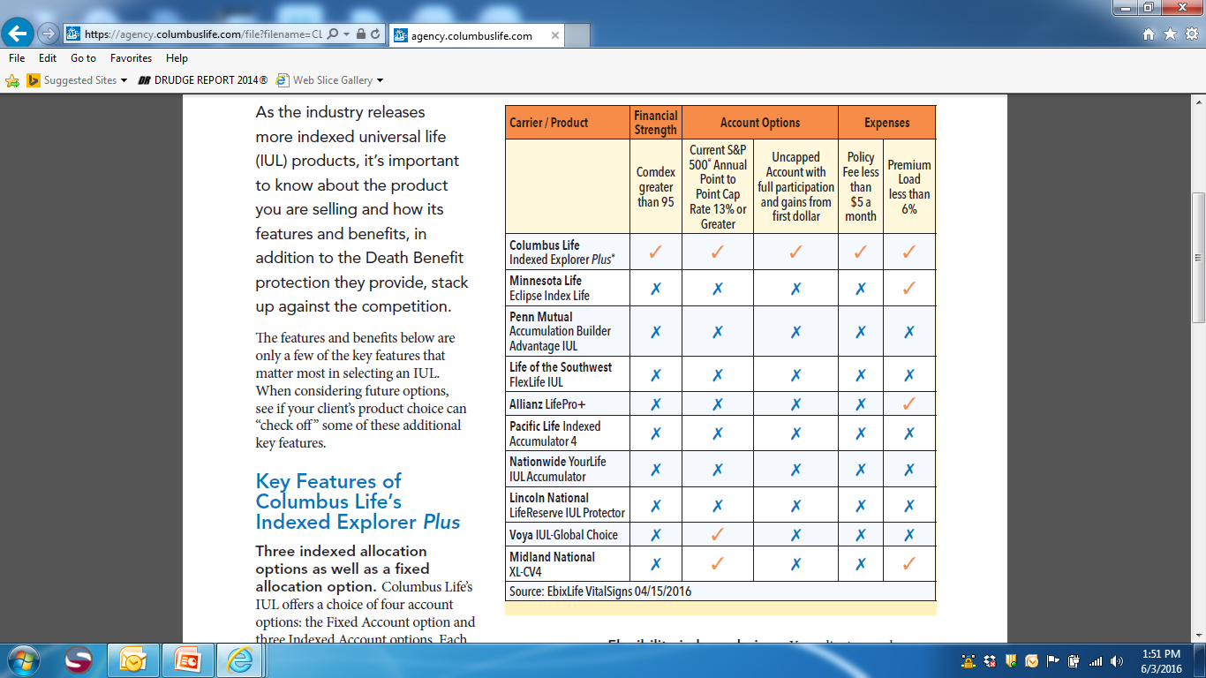

Slide 76
Income Potential
Standard Loans
Loans funds are taken from the fixed account. If funds are not sufficient, funds are transferred from indexed accounts to the fixed account.
Participating Index Loan
Loans are taken from the indexed accounts. There is no transfer of funds from the indexed to fixed accounts
Participating Index Loan option can allow funds to continue to grow at their respective rate!
Once a Standard Loan is selected can’t choose Participating Index Loan
Any loans or withdrawals will reduce the death benefit and will be subject to loan interest.
Notes:
…Participating Index Loan. We have two types of loans the previously mentioned Participating Index and the Standard Loan. Lets take a look at the difference between the two and the income potential of the participating index loan in the example of…

Slide 77

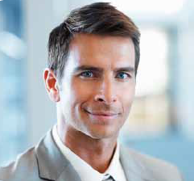
Case Study: Dan
Goal: 20-year income stream, 65–85
Male, age 45, preferred non-tobacco
$25,000 premium paid to age 65
Minimum non-MEC death benefit
Illustrated at current maximum illustrated rate
Company | Age 65 cash surrender value | Illustrated income stream**
Columbus Life* | $971,573 | $95,945
Allianz | $967,649 | $91,244
Minnesota Life | $954,924 | $92,615
AXA | $934,293 | $82,038
National Life/Life of the Southwest | $907,798 | $91,099
*Applied 27% Supplemental Coverage Rider
**Income uses withdrawals switching to loans at cost basis. Uses Option 2 switching to Option 1 at distribution. All values non-guaranteed. Assumes client lives in Ohio. Allocations are to 100% annual point-to-point with the 0% floor elected. Illustrated as of 7/5/2016. Any loans or withdrawals can reduce the death benefit and may be subject to loan interest.
Bonuses Included for Minnesota Life, Allianz and National Life/Life of the Southwest. Competitor information is obtained from sources believed to be reliable
Notes:
Let’s look at an example on how the Indexed Explorer Plus with its participating index loan might benefit a 45 year old male looking for death benefit protection and a supplemental retirement income stream and look at how we fare compared to some of our top competitors. In this example we have Dan who may be able to get a tax-free 20-year income stream with his Indexed Universal Life policy through a or a participating loan.
(CLICK)
Read through the case study on the slide.
These numbers are run based upon current assumptions, and may be more or less favorable dependant on policy performance.
Note that for our product we applied a 27% supplemental coverage rider to match the highest target premium of Minnesota Life.
Now let’s look at our next differentiator…

Slide 78

Case Studies
Male, age 60, Standard
Goal: LTC Alternative
“New Blue Mutual” $250k/day, 3yr benefit
John, 60
Option 1 | $6,828 Annual
Age 80 | $456,000
20 yr Cost | $136,560
Notes:
His plan is to reduce his death benefit to $250,000 but to take withdrawals for 4 years, 18 years from now when his grandchild is entering college. He still is only paying his premium for 30 years until age 75 and it has only increased by less than $500 annually for a lifetime coverage and supplemental college savings for his grandchild. John is able to take $7,000 for four years to help his grandchild with college expenses and age 90 he still has a current death benefit of $247,452.

Slide 79
Case Studies
Male, age 60, Standard
Goal: LTC Alternative
“New Blue Mutual” $250k/day, 3yr benefit
John, 60
Option 2 | $16,488 Annual
Age 80 | $1,100,000
20 yr Cost | $329,760
Notes:
His plan is to reduce his death benefit to $250,000 but to take withdrawals for 4 years, 18 years from now when his grandchild is entering college. He still is only paying his premium for 30 years until age 75 and it has only increased by less than $500 annually for a lifetime coverage and supplemental college savings for his grandchild. John is able to take $7,000 for four years to help his grandchild with college expenses and age 90 he still has a current death benefit of $247,452.

Slide 80
Case Studies
Male, age 60, Standard
Goal: LTC Alternative
Columbus Life Indexed Explorer Plus
$500k Single Premium
John, 60
Age 80
Death Benefit | $1,857,608
Cash Value | $766,109
Notes:
His plan is to reduce his death benefit to $250,000 but to take withdrawals for 4 years, 18 years from now when his grandchild is entering college. He still is only paying his premium for 30 years until age 75 and it has only increased by less than $500 annually for a lifetime coverage and supplemental college savings for his grandchild. John is able to take $7,000 for four years to help his grandchild with college expenses and age 90 he still has a current death benefit of $247,452.

Slide 81
Case Studies
Male, age 60, Standard
Goal: LTC Alternative
Columbus Life Indexed Explorer Plus
$500k Single Premium
Age 80 | Chronic Illness
Option 1 | Lump Sum $1,1016,109
Option 2 | $124,100 For 7.5 years
John, 60
Notes:
His plan is to reduce his death benefit to $250,000 but to take withdrawals for 4 years, 18 years from now when his grandchild is entering college. He still is only paying his premium for 30 years until age 75 and it has only increased by less than $500 annually for a lifetime coverage and supplemental college savings for his grandchild. John is able to take $7,000 for four years to help his grandchild with college expenses and age 90 he still has a current death benefit of $247,452.

Slide 82
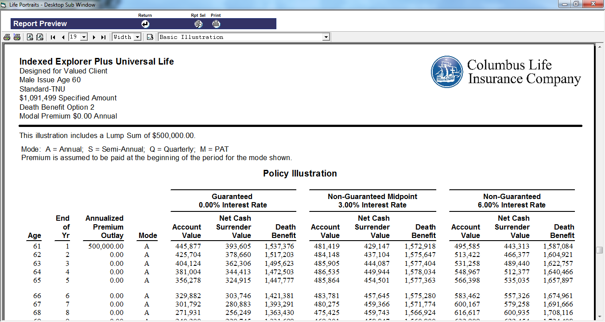
Columbus Life’s Product Portfolio
Unleash the Potential of
Thank You
for joining us today
The information contained herein is general in nature, is provided for informational purposes only, and should not be construed as legal or tax advice. Columbus Life does not provide estate planning, legal, or tax advice. Columbus Life cannot guarantee that such information is accurate, complete, or timely. Laws of a particular state or laws that may be applicable to a particular situation may have an impact on the applicability, accuracy, or completeness of such information. Federal and state laws and regulations are complex and are subject to change. Changes in such laws and regulations may have a material impact on pre- and/or after-tax investment results. Columbus Life makes no warranties with regard to such information or results obtained by its use. Columbus Life disclaims any liability arising out of your use of, or any tax position taken in reliance on, such information. Always consult an attorney or tax professional regarding your specific legal or tax situation.
© 2016 Columbus Life Insurance Company. All rights reserved.

Slide 83
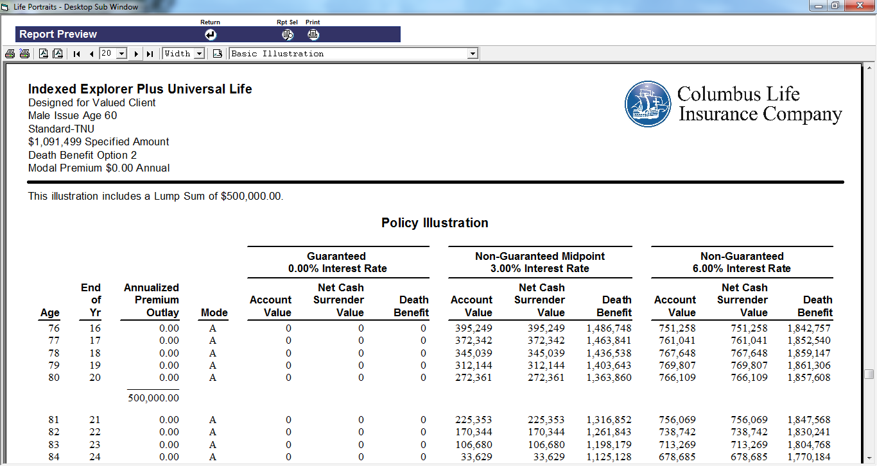

Slide 84



Life Plus
Accelerated Death Benefit Rider®
no additional premium cost
Available on All Universal Life Products and Nautical Term®
Terminal Illness
Triggering
Criteria
Chronic Illness
Specified Medical Condition
Product and Rider availability, provisions, definitions and benefits may vary by state. Check your illustration for state variances. In some states, benefits from the LifePlus Accelerated Death Benefit Rider are not available during the contestable period of the policy, as defined by the state of issue. In most states, benefits are not available for Chronic Illness until after the second policy anniversary, as defined by the state of issue.
Chronic illness underwriting guidelines will be used to determine eligibility for the LifePlus Accelerated Death Benefit Rider. Insured's who do not meet the underwriting guidelines, contingent on state availability, age and rate class received, will receive either the Accelerated Death Benefit Plus Rider or the Accelerated Death Benefit Rider
Notes:
Our second differentiator is the LifePlus ADBR and is available on all our Universal Life products and Nautical Term at no additional premium cost.
This rider allows the client the flexibility to receive an advance portion of the life policy’s death benefit, providing the client meets one of three qualifying events.
Our Life Plus riders let clients access a portion of their benefit at the onset of a terminal illness, critical illness, or chronic illness. In other states, the third trigger is permanent nursing home confinement or specified medical condition. Product and Rider availability, provisions, definitions and benefits may vary by state. Please consult your illustration for product features and availability, as they vary by state.
Your clients may find peace of mind that comes from the living benefits in life insurance.
As your client works toward saving for future needs, the death benefit protection helps provide for beneficiaries if your client dies prior to reaching those goals. The enhanced cash value accumulation potential through indexed interest crediting may improve the policy’s ability to provide supplemental sources of income or provide funds through the Life Plus rider and can help protect a client’s financial resources in the event of a triggering event.

Slide 85
SIMPLE Benefits Calculation
Columbus Life uses a formula method to calculate the benefits available for acceleration.
May be easier for clients to understand versus being subject to an “underwriting review” or a “discounted death benefit”
Notes:
Keep in mind the use of the formula method to calculate the benefit may be easier to understand and know what you could receive. Some carriers use the underwriting review method, some use a discounted death benefit method which discounts the amount given by a present value of the death benefit accelerated. Each methods has its own positives and negatives.
One thing that is beneficial about the formula method is that it is easier to see what the benefit would look like in an illustration…what it would mean in dollars should a triggering event occur.
Lets take a look at the calculations.

Slide 86
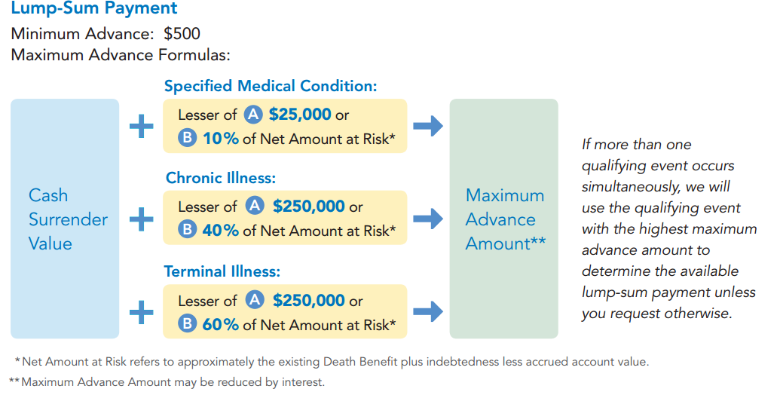
Life Plus
Accelerated Death Benefit Rider®
How Benefit is Calculated
Not available for use in California. The Life Plus Accelerated Death Benefit Rider® Series CLR-201 1208 is available on Policy Series CL 83 0405 and CL 83-U 0405. Also referenced: Accelerated Death Benefit Rider Series CLR-161 1208. Life Plus rider’s availability, provisions and benefits may vary by state.
Notes:
Read formulas…
Now with the Chronic Illness formula there is an additional option available…

Slide 87
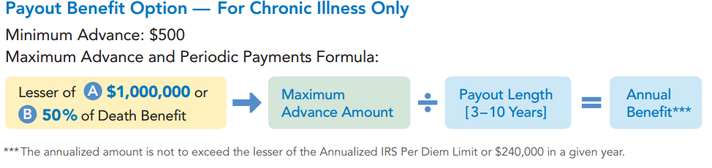
Life Plus
Accelerated Death Benefit Rider®
How Benefit is Calculated
Not available for use in California. The Life Plus Accelerated Death Benefit Rider® Series CLR-201 1208 is available on Policy Series CL 83 0405 and CL 83-U 0405. Also referenced: Accelerated Death Benefit Rider Series CLR-161 1208. Life Plus rider’s availability, provisions and benefits may vary by state.
Notes:
Read formula…

Slide 88
Summary
Index Strategy and Strong Income Potential of our Indexed Explorer Plus
Competitive Guaranteed Universal Life
Advantage Fixed Indexed Annuities Goldman Sachs Strategy and Income Potential
Flexible Living Benefits of LifePlus Rider
Capital Transfer Program
Notes:
Go over summary of the differentiators and key points.

Slide 89



External Term Exchange Program
Exchange Another Carrier’s Term Policy
For
Notes:
Your client can exchange any existing term policy, which must be a preferred or standard policy and issued within the last five (5) years by any North American insurance carrier, except US Financial & Mutual of Omaha and similar companies for any Columbus Life permanent insurance plan. They can take another carriers term policy and exchange it for a Explorer Plus, or Voyager even a Indexed Explorer Plus policy. And they will receive the same standard or preferred rating class as the original policy. There are some restrictions however….

Slide 90
External Term Exchange Program
Eligible Policies
Face Amount: $100,000 - $1,000,000
Rating: Standard or better
Issued: 6-60 months of Application Date
Must be in Contractual Convertible Period and submit original term policy or duplicate
Absolute assignment of policy required, no Partial Term Exchange
Full or lesser amount may be converted but original term policy must be surrendered
Notes:
Face amount $100,000-1,000,000-not to exceed internal retention including any previous Columbus Life policies
Term policy rated standard or better and issued between 6 and 60 months of application date
Issue ages 18-65
Policy must be in its contractual convertible period
Original term policy or full duplicate policy must be submitted. Lost policy declaration forms will not be accepted
Absolute assignment of the term policy is required. No partial term Exchanges will be considered
The full amount or a lesser amount may be converted but the original term policy must be surrendered - No increases will be considered

Slide 91

External Term Exchange Program
List of Eligible Carriers
Notes:
Read over eligible carriers slide

Slide 92
PLAN FOR LIFE with AMERICAN NATIONAL
Brooke T Malley, CLU®,CHFC®, National Sales Manager

Slide 93
Why Consider Signature GUL?

Slide 94

The Power of the Pig
Term vs Signature GUL
-the less “expensive” option.
-Limited options.
-ABRs available?
-Signature GUL- “Power of the Pig”.
- “Crack the Bank”
-ABRs

Slide 95

College Planning
38 Y/O Female
Twin Daughters-1 years old
Insurance Need 1 Million
Buy two 500k GUL
~$2,400/yr. ea. ($200/mo.)
~$4,800/yr. total ($400/mo.)

Slide 96
College Planning
Cash Out Options
Year 15-(least Likely to use, but available)
$23,252 of cash (65% of premiums paid) ea. Total $46,504
Year 20-(possible)
$47,901 of cash (100% of premiums paid) ea. $95,802 total
Year 25(also possible)
$59,876 of cash (100% of premiums paid) ea. $119,752 total.
…But why did I buy Two instead of One? What are my other options?
Take the cash from one and pay off the other one with lump sum
Take cash from one, buy retirement vehicle (maybe SPIA, hey ANICO has great SPIAs) and keep other.
…many options by purchasing multiple policies.

Slide 97
Insuring Your Insurance
Fully funded IUL for Retirement.
Has ABRs, but do you want to risk your retirement assets in the event of a Critical/Chronic Illness.
Why not Insure your Insurance?
Purchase Signature GUL as complimentary policy
If Critical/Chronic Illness, can use the SGUL for claim
If no claim, year 15, 20, 25 can cash out and “dump in” lump sum to IUL or pay off other obligation.

Slide 98
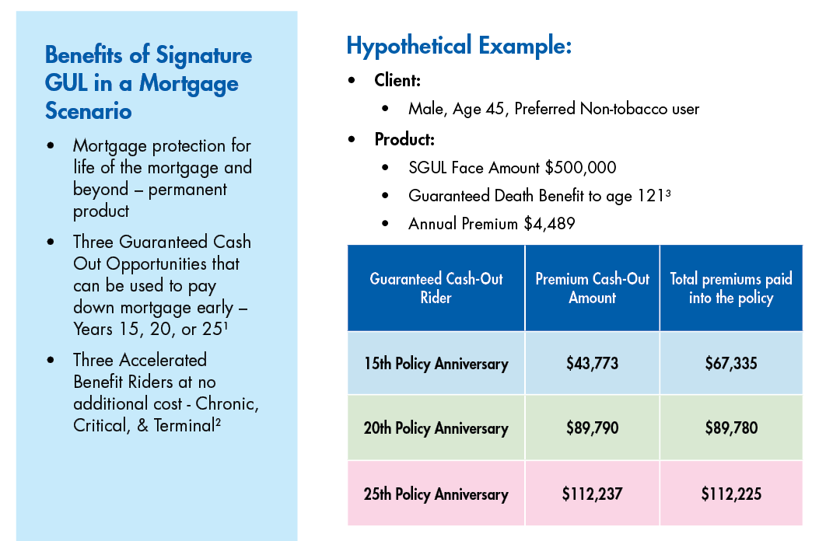
Mortgage Protection
For Agent Use Only; Not for Distribution or Use With Consumers.

Slide 99
Mortgage Protection
Benefits of Using the Cash-Out Rider as a Lump Sum Pay Down: |  |  | Benefits of Incremental Pay Down
Year 15: Lump sum principal payment of $43,773 Pay off Mortgage 30 months early Total Interest Paid: $378,187.76 (savings of $33,845.80) | Year 20: Lump sum principal payment of $89,790 Pay off Mortgage 51 months early Total Interest Paid: $378,918.55 (savings of $33,115.01) Age 65, close to retirement- free up $2,533.43 per month | Year 25: Lump sum principal payment of $112,237 Pay off Mortgage 48 months early Total Interest Paid: $401,527.30 (savings of $10,506.26) | Pay Down Early – Extra Principal Payment(s) - Pay One Extra Payment (monthly) Pay additional $212 Monthly Pay off Mortgage 53 months early Total Interest Paid: $342,561.52 (savings of $69,472.04)
For Agent Use Only; Not for Distribution or Use With Consumers.
Policy is terminated when utilizing Cash-Out Rider – no life coverage.

Slide 100

Divorce Planning
Jim and Mary (32 y/o) divorce.
3 kids 4, 2, 1
Jim $150k/year
Mary stay at home mom
Divorce Decree
$3,500/mo. (decreasing as each child reaches 18)
Full college tuition for all 3
$1,500/mo. alimony
Required to purchase life insurance on his life with MARY as beneficiary to ensure the above is fulfilled……..what was that amount………….

Slide 101
Divorce Planning
The Need
The Options
Total Child support obligation as long as all children remain healthy =18 years=$657,000
Total Alimony assuming Mary lives to at least age 80 and does not remarry=(at least)=$936,000
They negotiate a $1,000,000 life insurance policy to cover the need.
Term
Assuming Pref NT
$960/year
ABRs?
Limited options
GUL
$4,172/year
ABRs
Year 15-$40,679
Year 20-$83,443
Year 25-$104,304
….Wouldn't he rather have options in years 15,20, and 25 than just pay premiums to benefit his EX-WIFE if he DIES?????????????

Slide 102

Buy-Sell Agreement
Most plans funded with term.
Reviews for “new” or “old” type of term.
Consider using Signature GUL
Death Benefit Coverage
Critical/Chronic illness Coverage
Cash out in years 15/20/25 available for buy-out, debt reduction, or retirement.

Slide 103

Key Person
Bob (45) is Key employee at XYZ Manufacturing
Employer Purchases 300k Signature GUL on Bob.
DB to cover the loss of the key employee.
ABRs to cover Critical/Chronic Illness of Bob
BUT ALSO in 20 years when Bob retires, XYZ can offer Bob a nice retirement “bonus”
Or
Get their premiums back as they no longer need the coverage on Bob

Slide 104
Complete Life, Annuity, and Pension Portfolio
Annuity Solutions
Life Insurance Solutions (Individual and Simplified Issue for Worksite Marketing)
Fixed
Palladium MYG(NY too)
WealthQuest Citadel Diamond 5/7 (NY too)
Palladium Century
SPIA
Palladium SPIA (NY too)
Indexed
ANICO Strategy Indexed Annuity Plus 7/10 (NY too)
Term Insurance
ART, 10, 15, 20, 30(NY too) (SI Too)
Signature GUL(NY too) (SI too)
Executive UL (NY too) (SI too)
Signature Whole Life (NEW too)
Signature IUL(NY too)
Signature IUL+(NY too)

Slide 105

Underwriting Express

Slide 106

#1 REASON To Sell..Plan for What Matters Most!!!

Slide 107
Introducing… The Perfect Employee

Slide 108
If you could describe the qualities of a perfect employee they may include:
Hard Worker
Team Player
Skilled
Loyal
Honest

Slide 109
Since we are talking the “perfect employee” they also should be:
Disciplined
Action Oriented
Creative
Problem Solver
Adaptive

Slide 110

What if, in addition to all the aforementioned qualities, this employee also
Willing to work without sick days or vacation days?
No need for you to pay unemployment benefits or workers compensation?
Doesn’t require health benefits?
No need for a retirement plan?

Slide 111
AND, this employee was able to increase YOUR potential retirement income by…
$50,000 per year of
tax-free income for YOU
The Owner?

Slide 112
What would you, as a business owner, be willing to pay for such a person?
$50.00
per hour?
$20.00
per hour?
$15.00
per hour?

Slide 113
What if they would go to work for you for...
Minimum wage
$7.25 per hour?

Slide 114
In addition to the initial death benefits your insurance policy riders may also include the following Living Benefits
Waiver of Premium (WSP)
Terminal Illness (ABR)
Chronic Illness (ABR)
Critical Illness (ABR)
Critical Injury (ABR)
Over Loan Protection (OPR)
Guaranteed Income (LIBR)
Note: Riders are subject to underwriting approval and may not be available in all states.
See full illustration for values illustrated and benefits included
. Available upon request by contacting John Lovejoy, Regional Sales V.P. jlovejoy@nationallifegroup.com

Slide 115
Meet the perfect employee
YOUR PICTURE
YOUR NAME
I’ll start work today!

Slide 116
Here’s how my plan can work for you.
See Full Illustration for details.
For help with an illustration please call: 800.906.3310, Option 1 for Life Illustrations

Slide 117
For more information on products and services available from National Life Group contact me at:
John Lovejoy:
lovejoy.nlg@gmail.com (c) 502.321.0036

Slide 118
The Power of a Reserve Chute

Slide 119


Have you ever wondered why people jump from an airplane at 10,000 feet?
But we should plan for it to be this!
We would LOVE for it to be this

Slide 120

Sometimes in life even the most carefully prepared plans can go wrong so its wise to…
Have a reserve chute ready to deploy

Slide 121

You are hopeful you will never need it but…
It will only take once to make you glad you had a backup plan!

Slide 122




Life Insurance with Living Benefits
Notes:
Solving life's puzzle is not easy, but the companies of National Life Group have been providing solutions you and your clients need, when you need them since 1848.
The puzzle will continue to be an anchor of how we approach the marketplace. It is a story that will continue to set you apart from the competition.
(Transition to next slide)

Slide 123



ACCELERATED BENEFITS RIDERS (ABR’S)
Terminal Illness
Chronic Illness
Critical Illness
Critical Injury
Riders are supplemental benefits that can be added to a life insurance policy and are not suitable unless the client has a need for life insurance
Notes:
Accelerated benefits riders are optional riders that can be added to a life insurance policy and that give the policyholder access to the death benefit early, with a qualifying illness or injury during their lifetime. There is no additional premium for these riders because the policy holder is accelerating their death benefit on a discounted basis and the benefits can generally be used for anything.
We will cover each of the riders and how discounting works.
There are state specials and not all benefits and qualifying events are available in all states. You can find more information in the Accelerated Benefits Guide for agents.

Slide 124
LIBR: Guarantees you’ll love
Guaranteed
Tax Free Death Benefit
Guaranteed
To last as long as you live
Guaranteed
To keep the policy in force
Guaranteed
No annual loan paperwork
Guaranteed
No worries over loans lapsing your policy
Guaranteed
To never make another premium payment
Guaranteed
To help you experience life
Guarantees are dependent upon the claims paying ability of the issuing company. Benefits assume the client meets the qualifications to exercise the rider. Exercising the LIBR benefit may reduce or eliminate other policy and rider benefits
For Agent Use Only-Not For Use With The Public
Notes:
LIBR:
Guaranteed tax-free benefit payment
Guaranteed to last as long as you live, once the client meets the qualifications to exercise the rider.
Guaranteed to keep the policy in force
Guaranteed no loan paperwork every year
Guaranteed no worries over loans lapsing your policy
Guaranteed to never make another premium payment once it start
Guaranteed to help you Experience Life

Slide 125
LIFE INSURANCE POLICY CUSTOMIZATION THROUGH RIDERS
Accelerated Benefits Riders*
Need for Cash in the event of illness or injury
Children’s Term Rider
Insurance coverage for a child
Additional Insurability Option
Options for more coverage if change
in health
Balance Sheet Benefits Rider
Higher CSV on Business Balance Sheet
Overloan Protection Rider*
Take income without risk of policy lapse
Lifetime Income Benefit Rider*
Supplemental retirement income
Other Insured Rider
Coverage for Spouse, Child, Business Partner
Additional Protection
Benefit Rider
Dial down cost/increase policy values
Systematic Allocation Rider
Take advantage of multiple index points on a single premium
Waiver of Specified Premium / Waiver of Monthly Deduction
Protection in the event of disability
Death Benefit Protection Rider
Guaranteed death benefit protection for some period of time
*Restrictions, limitations and conditions for exercising apply – please refer to www.nationallifegroup.com for details.
Riders are optional, may require additional premium and may not be available in all states. Receipt of rider benefits may reduce or eliminate other policy or rider values and may be a taxable event.
Substantial limitations apply to exercising the Overloan Protection Rider, including that the policy be in force for at least 15 years and the insured having attained the age of 75.
Accidental Death Benefit
Additional protection in the event of an accident
Qualified Plan Exchange Privilege
Options for keeping coverage at
retirement or employment termination
TC87422n(1015)P
For Agent Use Only-Not For Use With The Public
Notes:
It is important to understand the riders available to help you customize solutions for your clients.
READ SLIDE

Slide 126


NEW PRODUCER PORTAL
For Agent Use Only-Not For Use With The Public
For Agent Use Only - Not For Use With The Public
Notes:
If you’re looking to learn more about our products, programs and tools, our new agent portal will be a resource you will begin to depend on.
The new site will be launching in February and was designed with one guiding principle in mind…..to make it easy.
We want to make it easy for you to find what you’re looking for, and we want you to have an exceptional experience every time you visit the site.
As you can see, you will have six categories to choose from:
My Dashboard
New Business
Commissions
Marketing
Training & Product
Inforce
And you will have easy access to all the tools you need to run your business.
Look for more information on this in the coming weeks.

Slide 127
Sales Strategies
Brett Novielli, RVP of Life – East Region
For financial professional use only – not for public distribution.
PPT-353 2/2017

Slide 128
Agenda
Diversification
Idle Assets- Reposition
Executive compensation

Slide 129

Allianz FIUL target customer
Target client profile:
Need life insurance coverage
Affluent, high wage earners
30-55 years old and healthy
May have estate planning needs
Small-business owners
Who are you looking for?
Notes:
First, let’s start by discussing the target customer.
Of course, Allianz FIUL insurance policies provide your clients the reassurance of knowing that if the unexpected happens, their loved ones would receive a death benefit income-tax-free that can be used for income replacement, paying off debt, supplemental college funding, and more.
But Allianz FIUL insurance policies do much more, by providing the opportunity to accumulate cash value that may be used for various purposes such as supplemental retirement income or other needs on a tax-deferred basis. Using policy loans and withdrawals, your clients have the potential to access any available cash value income-tax-free.
Allianz Life Pro+ may be a solution for an individual who wants to provide death benefit protection for their beneficiaries, and also the opportunity for potential cash value accumulation.
Allianz Life Pro+ Survivor may be a good fit for a couple, or business partners, who want a survivorship policy that provides death benefit protection to beneficiaries, after they have both passed away.
Allianz FIUL insurance policies can be an effective solution for:
Consumers who need life insurance coverage
Consumers who are affluent/higher wage earners who may be looking for death benefit protection for estate planning or other financial purposes
Consumers who are between the ages of 30-50
Consumers who are concerned about future tax increases and want the opportunity to accumulate cash value on a tax-deferred basis.

Slide 130
FIUL can benefit a financial strategy regardless of the tax environment
LOWER-TAX environment
HIGHER-TAX environment
Accessing from FIUL (or other income-tax-free sources)
Accessing from other taxable sources
Accessing from taxable sources
Accessing from FIUL as needed (or other income-tax-free sources)
Notes:
Let’s take a look at two of the many possible scenarios that could occur during retirement. These examples consider only one feature of the product.
Helping address retirement income needs in a LOWER-TAX environment
If the tax rate is lower when you retire than it was while your policy’s cash value was accumulating, you may consider accessing more from sources that create taxable distributions.
You can access loans and withdrawals from any available cash value in your FIUL policy if you need to help bridge your retirement income gap. But if you don’t need to access the policy’s cash value, it will continue to have the opportunity to accumulate and the death benefit will remain (not to be reduced) in case of an unexpected death.
Helping address retirement income needs in a HIGHER-TAX environment
If the tax rate is higher when you retire than it was while your policy’s cash value was accumulating, it may make sense to access more from your FIUL policy, assuming there is cash value available, to supplement retirement income. This is because the amounts you access through policy loans (and withdrawals up to amount of the premiums you paid) are income-tax-free. Loans from your policy could help fill more of the retirement income gap, assuming there is available cash value to access. You could also access other income sources, as needed.

Slide 131
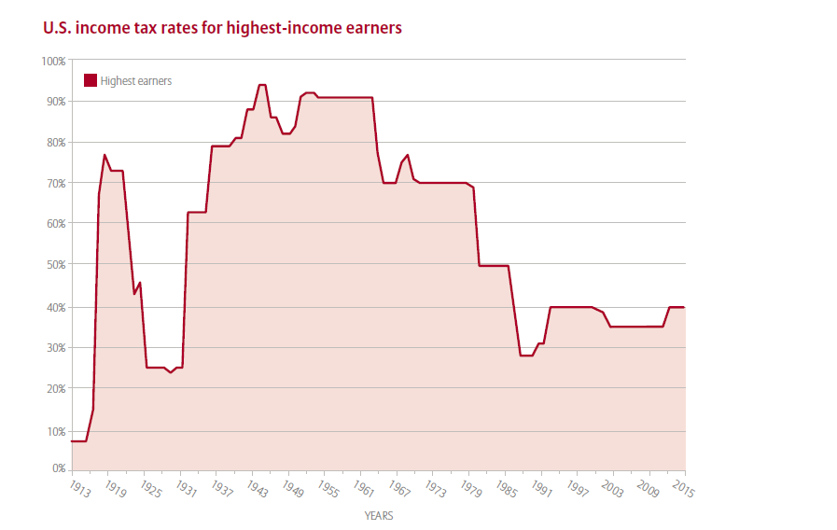
Tax diversification in a financial strategy
Source: Tax Policy Center, “U.S. Individual Income Tax: Personal Exemptions and Lowest and Highest Tax Brackets.”
Notes:
How much longer will it be before our historically low income tax rates could give way to big increases?
Taxes can have a significant impact on how much of their savings your clients get to use, and the amount they pass on to their beneficiaries. That’s why tax diversification is such an important part of your clients’ financial strategies. Tax diversification is a means of keeping assets in a variety of financial vehicles that are taxed differently.
Given the impact rising taxes may have, diversifying a retirement strategy to include FIUL can help lessen exposure to adverse tax impact by allocating to vehicles that offer different tax treatments.
In this chart you can see:
• The marginal income tax rate for the highest earners is currently hovering around 40%.
• Over the past century that rate has been significantly higher – and the current rate is relatively low compared to historical results.

Slide 132
Tax diversification in a financial strategy
Source: Tax Policy Center, “U.S. Individual Income Tax: Personal Exemptions and Lowest and Highest Tax Brackets.”
Notes:
How much longer will it be before our historically low income tax rates could give way to big increases?
Taxes can have a significant impact on how much of their savings your clients get to use, and the amount they pass on to their beneficiaries. That’s why tax diversification is such an important part of your clients’ financial strategies. Tax diversification is a means of keeping assets in a variety of financial vehicles that are taxed differently.
Given the impact rising taxes may have, diversifying a retirement strategy to include FIUL can help lessen exposure to adverse tax impact by allocating to vehicles that offer different tax treatments.
In this chart you can see:
• The marginal income tax rate for the highest earners is currently hovering around 40%.
• Over the past century that rate has been significantly higher – and the current rate is relatively low compared to historical results.

Slide 133
Tax diversification in a financial strategy
Source: Tax Policy Center, “U.S. Individual Income Tax: Personal Exemptions and Lowest and Highest Tax Brackets.”
Notes:
How much longer will it be before our historically low income tax rates could give way to big increases?
Taxes can have a significant impact on how much of their savings your clients get to use, and the amount they pass on to their beneficiaries. That’s why tax diversification is such an important part of your clients’ financial strategies. Tax diversification is a means of keeping assets in a variety of financial vehicles that are taxed differently.
Given the impact rising taxes may have, diversifying a retirement strategy to include FIUL can help lessen exposure to adverse tax impact by allocating to vehicles that offer different tax treatments.
In this chart you can see:
• The marginal income tax rate for the highest earners is currently hovering around 40%.
• Over the past century that rate has been significantly higher – and the current rate is relatively low compared to historical results.

Slide 134
Tax diversification in a financial strategy
Source: Tax Policy Center, “U.S. Individual Income Tax: Personal Exemptions and Lowest and Highest Tax Brackets.”
Notes:
How much longer will it be before our historically low income tax rates could give way to big increases?
Taxes can have a significant impact on how much of their savings your clients get to use, and the amount they pass on to their beneficiaries. That’s why tax diversification is such an important part of your clients’ financial strategies. Tax diversification is a means of keeping assets in a variety of financial vehicles that are taxed differently.
Given the impact rising taxes may have, diversifying a retirement strategy to include FIUL can help lessen exposure to adverse tax impact by allocating to vehicles that offer different tax treatments.
In this chart you can see:
• The marginal income tax rate for the highest earners is currently hovering around 40%.
• Over the past century that rate has been significantly higher – and the current rate is relatively low compared to historical results.

Slide 135
2
“Never Money” –
Asset Reposition
Notes:
Typically, when people are discussing their financial strategies in regards to retirement there are generally three categories that will be used for their assets.
Now Money:
This is the money that will be turned into income at the present time.
Later Money:
This pool of money is to be reserved for use at a later time for income for retirement or other financial concerns like health care.
And lastly, Never Money:
Never money is the pool of assets that has been identified through the financial planning process that will not be needed to maintain the clients lifestyle. It may also be money that they desire to leave to their beneficiaries or charitable interests.

Slide 136

Target clientele
Profile:
Age 45-65
Need life insurance coverage
Affluent, high wage earners
Identified Never Use/Idle Assets
Goals – Efficient transfer of the asset with cash accumulation potential for financial protection
Concerned about future tax increases
Notes:
Read slide

Slide 137

What is the goal of the money?
Protection
Accumulation Potential
Ease of Transfer
Access
Notes:
What are clients generally looking for in regards to where to allocate the “Never Money” category? Typically they are looking for 4 things.
Protection: This is an asset that they do not want to see diminished over time and the preservation of principal is valued more than the opportunity for accumulation of assets.
Accumulation Potential: The expectations for accumulation are desired as long as the principal is protected and not at risk.
Ease of Transfer: What will the process be for getting this money to the next generation or charity? Will it go through probate? What is the tax consequence?
Access: Even though this money is seen as an asset that will not be needed by the owner, it may be desired to have access to the assets in the case of some unforeseen need.

Slide 138

Meet Karen
Client Profile:
Female age 55
Affluent
200K of “Idle assets”
Goals for the money:
Pass to children and grandchildren
Access for emergencies
Notes:
Meet Karen.
Karen is in her mid 50’s and is feeling comfortable about her retirement planning. She has planned for income, health care and Long term care events. She has identified with her financial planner $200,000 that she will not need to support her retirement plans. Karen has decided that this money will go to her children and grandchildren, but also wants to have access to it just in case there is some unforeseen financial need. Karen has never money that she would like to see accumulate in a way that can be protected and will transfer efficiently to her loved ones. What can Karen do to help meet her goals? Here are two options.

Slide 139
FIUL as an Option
Allianz Life Pro+, non-guaranteed 7.00%, Level Death Benefit
EOY | Surrender value w/PDF | Surrender value IRR | Death Benefit w/PDF | Death Benefit IRR
1 | $158,400 | -20.80% | $1,239,181 | 519.59%
5 | $156,839 | -4.75% | $1,080,781 | 40.13%
10 | $216,759 | 0.81% | $1,080,781 | 18.38%
15 | $302,594 | 2.80% | $1,080,781 | 11.90%
20 | $401,934 | 3.55% | $1,080,781 | 8.80%
25 | $514,698 | 3.85% | $1,080,781 | 6.98%
30 | $629,963 | 3.90% | $1,080,781 | 5.78%
35 | $747,768 | 3.84% | $1,080,781 | 4.94%
Illustration assumes Female 55 Standard NT using a 5yr payment from PDF and illustrating a level DB and 7% credited interest for all years. All values include the remaining PDF account value.
Hypothetical example is provided for illustrative purposes only. Character is fictional and not an actual Allianz client. Based on historical performance, the allocation options, had they been available, would have resulted in a wide range of interest rates. Some would have exceeded 7.00% and some would have been less than this. Using the guaranteed minimum rate of 0.1%, the policy would lapse in year 15.
Keep in mind that different time periods and different indexes would produce higher or lower averages. The interest rate credited is based on the caps or participation rates in the policy and is subject to change on any policy anniversary based on several external factors including, but not limited to, market volatility, short-term interest rates, and long-term interest yields.
Notes:
Karen, along with her financial planner, has identified Allianz Life Pro+ Fixed Index Universal Life Insurance Policy and the Premium Deposit Fund rider could fit her need. Notice that the available cash value for Karen starts to show positive performance around the 10th year in this illustration for the $200K that was allocated to the FIUL. On the other hand the Death benefit is quite attractive throughout in the case of an early death. As we allow the policy to work over time it has the potential to offer cash value accumulation potential and assets available for transfer. All this and the benefit of an income tax free death benefit, tax deferred accumulation and potential tax free distributions in the form of loans or withdrawals.
The internal rate of return (IRR) column in these charts is a calculation that shows the average rate of return the original $200K allocated premium may achieve based on the illustrated rates, current fees and charges, at death, or full surrender of the life insurance policy. Keep in mind, life insurance is not an investment vehicle.
Notice that the Surrender value IRR increases and the Death Benefit IRR decreases as more premiums are paid into the policy and index and interest credits are applied.
Using the guaranteed minimum interest rate of 0.1%, the policy would lapse in year 15.

Slide 140
Another Option using FIUL
Allianz Life Pro+, non-guaranteed 7.00%, B to A switch in year 7
EOY | Surrender value w/PDF | Surrender value IRR | Death Benefit w/PDF | Death Benefit IRR
1 | $168,118 | -15.94% | $920,406 | 360.20%
5 | $181,362 | -1.94% | $931,733 | 36.04%
10 | $251,573 | 2.32% | $726,154 | 13.76%
15 | $361,845 | 4.03% | $726,154 | 8.89%
20 | $513,562 | 4.83% | $726,154 | 6.66%
25 | $740,527 | 5.38% | $777,553 | 5.58%
30 | $1,079,447 | 5.78% | $1,133,450 | 5.95%
35 | $1,561,877 | 6.05% | $1,639,971 | 6.20%
Illustration assumes Female 55 Standard NT using a 5yr payment from PDF and illustrating an increasing DB and 7% credited interest for all years. The Death Benefit is switched to Level in yr. 7. All values include the remaining PDF account value.
Hypothetical example is provided for illustrative purposes only. Character is fictional and not an actual Allianz client. Based on historical performance, the allocation options, had they been available, would have resulted in a wide range of interest rates. Some would have exceeded 7.00% and some would have been less than this with the guaranteed interest rate being 0.1%. Using the guaranteed minimum interest rate of 0.1%, the policy would lapse in year 19.
Keep in mind that different time periods and different indexes would produce higher or lower averages. The interest rate credited is based on the caps or participation rates in the policy and is subject to change on any policy anniversary based on several external factors including, but not limited to, market volatility, short-term interest rates, and long-term interest yields.
Notes:
If Karen and her planner decide that they would like to see potential accumulation earlier in the illustration here is another option. Here you will notice that the available cash value starts to illustrate positive around year 10 and continues to accumulate at a faster rate than the level death benefit option. Noticeably, there is less death benefit until around the 30 year with this option though as far as an internal rate of return is concerned it is still a positive and efficient transfer of the assets through the death benefit.
Both options are possibilities to meet Karen’s goals for these idle assets
Notice that the Surrender value IRR increases and the Death Benefit IRR decreases as more premiums are paid into the policy and index and interest credits are applied. Keep in mind, life insurance is not an investment vehicle.
Using the guaranteed minimum interest rate of 0.1%, the policy would lapse in year 19.

Slide 141
Executive Compensation Strategies
An introduction to small-business owners
PPT-239 R-12/2015

Slide 142
What is an executive bonus plan?
A tax-deductible way for you to provide a bonus to reward and retain key employees.
Bonus is paid by employer as premium on a life insurance policy for key employee
Key employee is the owner of the policy and designates a beneficiary
Premiums paid are considered salary to key employee and is taxable to the key employee
Notes:
Lets start by giving a brief overview of what is an executive bonus plan is. It is a tax-deductible way for you (the business owner) to provide a bonus to reward and retain key employees.
The bonus is paid by the employer as a premium on a life insurance policy, the employee applies for a life insurance policy and is named the owner of the policy. The insured employee also names the beneficiary of the policy. For convenience, you the employer can pay the premium on behalf of the employee directly to the life insurance company.
Premiums are bonuses to the employee, so they are similar to salary and treated like that for income tax purposes.
Sometimes these executive bonus plans are called Section 162 bonus plans – named after the Internal Revenue Code section that provides for the income tax deduction for salary and bonuses.
According to the 2013 LIMRA study “Small World: Trends in the U.S. Small Business Market” :
The loss of a vital employee can have a much more catastrophic impact on the survival of a small company than a large one.
Executive bonus plans can be a way to help recruit and retain your key employees.
Parties should consult with an attorney and tax advisor to discuss their specific situation.
Next slide.

Slide 143
Why use life insurance?
Recruit and retain key employees
Flexibility – you choose who participates
Death benefit protection for your employees
Cash value accumulation potential for future needs¹
Premium may be tax-deductible as a business expense
For more information on the tax implications of contributions to or distributions from this or any other employee benefit plan, consult your attorney or tax advisor.
¹Policy loans and withdrawals will reduce available cash values and death benefits, and may cause the policy to lapse or affect any guarantees against lapse. Additional premium payments may be required to keep the policy in force. In the event of a lapse, outstanding policy loans in excess of unrecovered cost basis will be subject to ordinary income tax. Tax laws are subject to change and you should consult your tax professional.
Notes:
Why would you use life insurance with an executive bonus plan for your employees?
In today’s competitive job market, you may have to offer more than just the basic benefits package to recruit and retain valuable employees.
An executive bonus plan is a valuable benefit because it provides life insurance coverage for your key employee(s) at little or no cost to them. The plan is straightforward to set up and administer, making it an easy and versatile way to attract, motivate, and retain key employees.
Unfortunately, the qualified retirement plan rules potentially make it more difficult for highly compensated employees to accumulate sufficient cash to maintain their standard of living. For example, under current law, the maximum permissible deferral to a 401(k) plan in 2015 is $18,000 (under age 50) and $24,000 (age 50 and older). This is not nearly enough for many highly compensated employees.
Executive bonus plans – which are sometimes called Section 162 plans – allow you to pay a bonus to any employee(s) of your choosing. The bonus can then be used to fund life insurance coverage for the employee and the employee’s family, and can serve as a tax deduction for your business when you write it off as employee compensation.
As an additional benefit, you could consider a life insurance policy (such as fixed index universal life) that offers cash value accumulation potential, which can allow employees to access any available cash value for future needs – including supplementing their income in retirement through loans or withdrawals.
For more information on the tax implications of contributions to or distributions from this or any other employee benefit plan, consult your attorney or tax advisor.
NEXT SLIDE

Slide 144



Executive bonus plan for all entities
Sole proprietor
Partnership
Limited Liability Corporation (LLC)
C Corporation
S Corporation
For more information on the tax implications of contributions to, or distributions from, this or any other employee benefit plan, consult your attorney or tax advisor.
Notes:
Executive bonus plans may be a benefit to employees of many different types of business entities.
You as the business owner have the freedom to choose incentives that not only create solutions for your business, but offer value to key employees.
Remember that you can be considered a key employee too.
The life insurance premiums are not income tax deductible for the business owner. (Remember that the only life insurance premiums that are ever tax deductible are for group life insurance plans.)
With an executive bonus plan, the money paid to key employees as a bonus is considered employee compensation and therefore income tax deductible to the company. The bonus is in turn used to pay the life insurance premium.
So this would also apply to a sole proprietor, as an employee of the business. Sole proprietors may be doctors, lawyers, dentists, CPAs, and financial professionals.
Executive bonus plans can be used for employees of:
Sole proprietor
Partnership
Limited liability corporation (LLC)
C corporation
S corporation
NEXT SLIDE

Slide 145
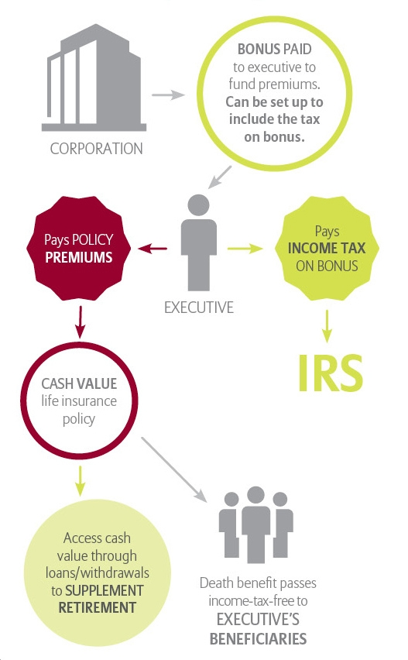
Life insurance as part of an executive bonus plan: How it works
This hypothetical example is provided for illustrative purposes only.
¹Policy loans and withdrawals will reduce available cash values and death benefits, and may cause the policy to lapse or affect any guarantees against lapse. Additional premium payments may be required to keep the policy in force. In the event of a lapse, outstanding policy loans in excess of unrecovered cost basis will be subject to ordinary income tax. Tax laws are subject to change and your clients should consult their tax professional.
Access available cash value through loans¹ to SUPPLEMENT RETIREMENT INCOME
Notes:
Many businesses choose to pay their bonuses in additional compensation, but you might consider offering your key people other choices. One option could involve using part – or all – of their bonus to purchase life insurance.
Here’s how it works:
Under the executive bonus plan, the employee purchases (and owns) a fixed index universal life (FIUL) insurance policy, using the bonus to pay the entire policy premium directly to the insurance company. The premium payment is reported in box 1 on the employee’s W-2 statement.
(This compensation is subject to Social Security (FICA) taxes if the employee’s pay is below the FICA wage base, as well as Federal Unemployment (FUTA) tax.)
Because the bonus is reported as compensation, you can deduct it as a business expense to the extent permitted under Section 162 (there are limits to deduction of compensation for certain executives).
What if the business just buys a life insurance policy without a bonus plan?
If you buy any interest in an individual life insurance policy on an employee, the premiums would not be tax deductible. (Life insurance premium is only a tax-deductible business expense when group term life insurance is purchased for all qualified employees.)NEXT SLIDE

Slide 146
Using a “double bonus”
Bonus employee enough to cover the taxes
Results in no out-of-pocket costs to employee
Formula for Double Bonus
Premium /1 – employee’s tax bracket
Example:
Premium: $100,000
Employee’s tax bracket: 40%
Double Bonus
$100,000
1 - .40
= $166,666
This hypothetical example is provided for illustrative purposes only.
Notes:
As we previously mentioned, the premium amount that you, the employer, is paying for the life insurance policy is taxable to the key employee. You also have the choice of stepping up the bonus to your key employee (or yourself) in order to cover the taxes. This is sometimes refer to as using a double bonus.
This chart hypothetically illustrates how this works.
NEXT SLIDE

Slide 147
Benefits to the employer
Reward and retain key employees
Premium payments are deductible if,
considered “reasonable” compensation
employer is not a beneficiary
No contribution limits
No administration costs
Control and flexibility of who participates
May discontinue at any time
Simple arrangement
For more information on the tax implications of contributions to, or distributions from, this or any other employee benefit plan, consult your attorney or tax advisor.
Keep in mind most life insurance policies require health and financial underwriting.
Notes:
There are also a number of benefits to you the employer with an executive bonus arrangement:
Reward and retain key employees
Premium payments currently deductible if:
considered “reasonable” compensation
employer is not be directly or indirectly a beneficiary
for certain employees of a publicly traded corporation, the deduction is limited to $1 million per employee
No contribution limits other than reasonable compensation, although there may be limits on premium allowed by the life insurance policy.
No administration costs; however, there are costs associated with the life insurance policy.
No participation requirements. Although keep in mind that most life insurance policies require health and financial underwriting.
May discontinue at any time
Simple arrangement

Slide 148
Benefits to the key employee
Income-tax-free death benefit
Tax-deferred cash value accumulation potential
Income tax-free access to any available cash value through policy loans or withdrawals
Secure from corporate creditors
Simple arrangement
Portable
Policy loans and withdrawals will reduce available cash values and death benefits, and may cause the policy to lapse or affect any guarantees against lapse. Additional premium payments may be required to keep the policy in force. In the event of a lapse, outstanding policy loans in excess of unrecovered cost basis will be subject to ordinary income tax. Tax laws are subject to change and you are encouraged to consult your tax professional. Policy loans are not usually subject to income tax unless the policy is classified as a modified endowment contract (MEC) under IRC Section 7702A. However, withdrawals or partial surrenders from a non-MEC policy are subject to income tax to the extent that the amount distributed exceeds the owner's cost basis in the policy. Loans, withdrawals or partial surrenders from a MEC policy are subject to income tax to the extent of any gains in the policy, and if the payment occurs prior to age 59 ^{1/2}, a 10% federal additional tax may apply.
Notes:
As a result of the executive bonus arrangement, there are a number of benefits and consequences to the employee:
Death proceeds received income tax-free to the beneficiaries of your key employee
Tax-deferred growth on potential cash value accumulation
Income-tax-free access to any available cash value via policy loans or withdrawals to help supplement retirement income, if policy is not a Modified Endowment Contract (MEC)
No tax penalty for early loans or surrenders if policy is not a MEC and so long as the policy does not lapse
Security from corporate creditors
Access to any available cash value before retirement without employer’s consent
Simple arrangement to understand
Portable – the life insurance is owned by the employee.
A consequence to the employee is that the bonus they receive to be used to pay the life insurance policy premium is treated as income and is taxable to the employee.
NEXT SLIDE

Slide 149
Additional considerations
Key employees are critical to the success and profitability of your business.
Employee can leave the company at any time and take the insurance policy
Employee must be insurable
Premium payments = taxable income to the employee
No golden handcuffs
Attorney to draft the bonus arrangement
Life insurance policies require health and financial underwriting
For more information on the tax implications of contributions to, or distributions from, this or any other employee benefit plan, consult your attorney or tax advisor.
Notes:
As with anything else, there are some additional considerations to an executive bonus arrangement.
For example:
Your key employee could terminate employment with the employer at any time and take the life insurance policy with him or her.
Also the employee must be insurable to do an executive bonus, though you could insure someone else and have the executive own the policy as long as the executive had an insurable interest in the other party.
A consequence to the employee is that the bonus they receive to pay the life insurance policy premium is treated as income and is taxable to the employee.
A concern for executive bonus arrangements is that there is no golden handcuffing with them – which means there are no strings with an executive bonus arrangement that would tie the employee to the company and promote company loyalty.
An attorney needs to be involved to draft the bonus arrangement.
The cost of life insurance needs to be considered in this strategy.
And finally, most life insurance policies require health and financial underwriting to qualify.
NEXT SLIDE

Slide 150
What is a REBA?
An executive bonus arrangement plus a GOLDEN HANDCUFF.
A “golden handcuff” is a restriction on the life insurance policy that prevents the employee from access to the available cash value without the employer’s consent.
Two parts to a REBA at Allianz
Executive bonus agreement drafted by an attorney
Restricted policy agreement form from Allianz
For more information on the tax implications of contributions to, or distributions from, this or any other employee benefit plan, consult your attorney or tax advisor.
Notes:
A restricted executive bonus arrangement (REBA) can be another way to attract and retain key employees. This type of special benefit can help the key employees build loyalty to the business without the complexities of other types of plans.
This type of executive bonus arrangement has a golden handcuff on the policy that restricts the employee’s access to the policy’s available cash value. The employee needs to obtain your consent to access the available cash value in the policy up until a certain date.
There are two parts to a REBA: an executive bonus agreement which is drafted by an attorney, and a restricted policy agreement form from Allianz.
A REBA provides a key employee with a bonus that’s used to fund a life insurance policy.
The life insurance policy which is structured for a REBA generally would have the executive employee named the owner of the policy.
Normally the executive employee is also the insured, however, if he/she is uninsurable, you could name someone else as the insured as long as the executive owns the policy and has an insurable interest in that other person (for example, a spouse could be named as the insured.) When the executive is also the Insured, then he/she names someone else as beneficiary of the policy. If someone other than the executive is the insured, then the executive is named as both the owner and the beneficiary of the policy.
This life insurance policy provides a death benefit to the employee’s family if the employee dies while the policy is in force. When special restrictions are included that limit the employee’s access to the policy’s available cash value until an agreed upon time, and possibly require the employee to pay back the employer all or part of the bonuses that are used to fund the life insurance policy, the REBA can be a powerful incentive for an employee to remain with the company.
Next slide.

Slide 151
Characteristics of a REBA
Executive is the insured, owner of the policy, and names a beneficiary
Employee cannot access cash value without employer’s consent
If the employee leaves the business, they may be required to pay back all or part of the bonus used to fund the life insurance
At a predetermined date the restrictions on the policy will be lifted
Notes:
Characteristics of a REBA:
Executive is the insured, owner of the policy, and names a beneficiary
Employee cannot access cash value without employer’s consent
If the employee leaves the business, they may be required to pay back all or part of the bonus used to fund the life insurance
At a predetermined date the restrictions on the policy will be lifted
Next slide.

Slide 152
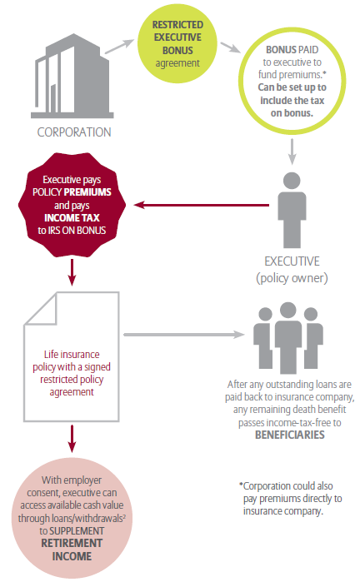
How a REBA works at Allianz
This hypothetical example is provided for illustrative purposes only. These characters are fictional and not actual Allianz clients.
Notes:
Here’s a hypothetical example of how a restricted executive bonus arrangement works.
Integrated, Inc. pays Michelle a bonus, and she pays a premium to fund a life insurance policy or, for convenience purposes, Integrated pays the premium on the policy directly to Allianz on behalf of Michelle and treats the premium as a bonus paid to Michelle.
Michelle is named the owner of the life insurance policy insuring her life, and she names the beneficiary of the policy.
The REBA requires two documents signed by the employer and the employee:
An executive bonus agreement that’s drafted by the employee’s or employer’s attorney and includes details on the bonus, restriction, repayment guidelines, termination date, etc.
A restricted policy agreement that restricts employee’s access to the available cash value unless the employer approves, and will include a predetermined date when the restriction terminates.
Integrated continues to make annual premium payments on behalf of Michelle while she remains employed with Integrated, as agreed upon by Michelle and Integrated. Michelle is taxed on those premiums as a bonus.
If Michelle works at Integrated until the applicable predetermined date, the restriction is lifted, and she then has entire control of the life insurance policy.
If Michelle quits working at Integrated before the applicable predetermined date, she may owe back some or all of the premium bonuses that were used to fund a life insurance policy.
If Michelle dies while the life insurance policy is in force, her chosen beneficiaries receive the death benefit on the policy.
NEXT SLIDE

Slide 153
Guarantees are backed by the financial strength and claims-paying ability of Allianz Life Insurance Company of North America. Products issued by Allianz Life Insurance Company of North America. Product availability and features may vary by state.
P95472 & P61843

Slide 154
How to Plan & Execute a Seminar

Slide 155
Agenda
Set Your Objectives & Strategies
Planning The Date, Location, Topic & Time
Marketing & Sales Coordination
Marketing Execution: Registration Form & Invitation
Seminar Presentation
Day of the Event Logistics
After the Event Follow-Through
Resources

Slide 156
Set Your Objectives & Strategies
Objective: sell ____________________________
What constitutes success?
# attendees
$ sales
Strategy:
Develop a detailed plan
Coordinate marketing & sales
Execute flawlessly
Leverage the VAR/ISV ecosystem…
Marketing
Sales
Technical Sales
Follow up and sell

Slide 157
Agenda
Set Your Objectives & Strategies
Planning The Date, Location, Topic & Time
Marketing & Sales Coordination
Marketing Execution: Registration Form & Invitation
Seminar Presentation
Day of the Event Logistics
After the Event Follow-Through
Resources

Slide 158

Planning the Date, Location, Topic & Time
Set the key details ASAP:
You cannot begin promotion until these details are locked:
Date
Location
Topic & Time
Setting the Date:
Consult the calendar and back into a seminar date based on your promotion schedule
Give yourself a week to plan the basic logistics and develop promotional materials
At least 3 emails, 3 weeks of promotion
Do not hold events on holiday weeks
Do not hold events on Monday or Friday
Event date: Thursday March 3rd
A reminder/confirmation email & call campaign a day or 2 before the event
Weekly sales call campaigns
✓
Today: planning kickoff

First email promo

Second email promo

Third email promo
Presidents Day

Fourth email promo

Reminder email + phone
Event Date

Slide 159
Planning the Date, Location, Topic & Time
Set the key details ASAP:
You cannot begin promotion until these details are locked:
Date
Location
Topic & Time
Setting the Location:
Choose a location that is central and convenient for your prospects
If you can’t name 10 pipeline accounts within 100 miles of your seminar location then don’t do a seminar. Do lead generation instead.
Make sure your facility has the appropriate technical setup (projector, internet if necessary)
It is OK to rent a function room at the local Holiday Inn for an end-user audience, but perhaps not for an executive audience
FREE: your own training facility, or a PTC office
A local university, a local country club
✓
✓

Slide 160
Planning the Date, Location, Topic & Time
Set the key details ASAP:
You cannot begin promotion until these details are locked:
Date
Location
Topic & Time
Setting the Topic & Time:
Do a half-day seminar, in the morning
People are too busy to take a full day out of the office
You can plan an optional second half of the day (golf, etc.)
Resources for seminar topics:
Seminar Materials on the Marketing page of the PTC Partner Portal
Marketing Toolkits on the Marketing page of the PTC Partner Portal
Don’t necessarily use the title of the sales presentation as the seminar topic
Shift your perspective: It’s not about what you want to sell, it’s about what your sales prospect wants to learn
✓
✓
✓

Slide 161
Agenda
Set Your Objectives & Strategies
Planning The Date, Location, Topic & Time
Marketing & Sales Coordination
Marketing Execution: Registration Form & Invitation
Seminar Presentation
Day of the Event Logistics
After the Event Follow-Through
Resources

Slide 162
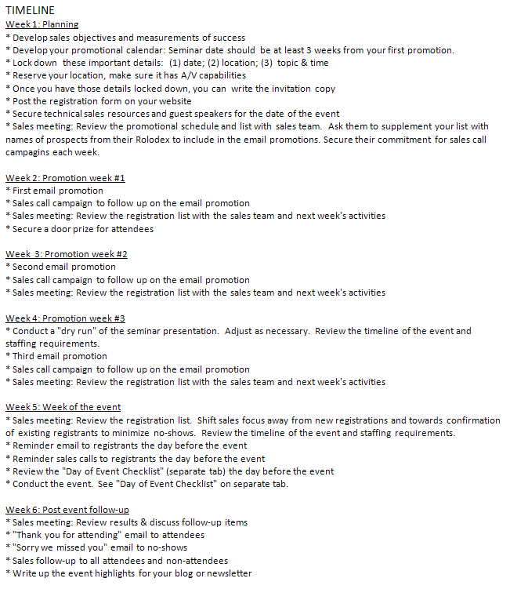
Marketing & Sales Coordination
Marketing – Sales Coordination is perhaps the single most critical factor for success:
Planning & goal setting
Augmentation of the marketing database with the sales Rolodex
Weekly status updates
Weekly sales call campaigns
Technical Sales/demo
Presentation “dry run”
Day-of-event execution
Post-event sale follow-through

Slide 163
Agenda
Set Your Objectives & Strategies
Planning The Date, Location, Topic & Time
Marketing & Sales Coordination
Marketing Execution: Registration Form & Invitation
Seminar Presentation
Day of the Event Logistics
After the Event Follow-Through
Resources

Slide 164
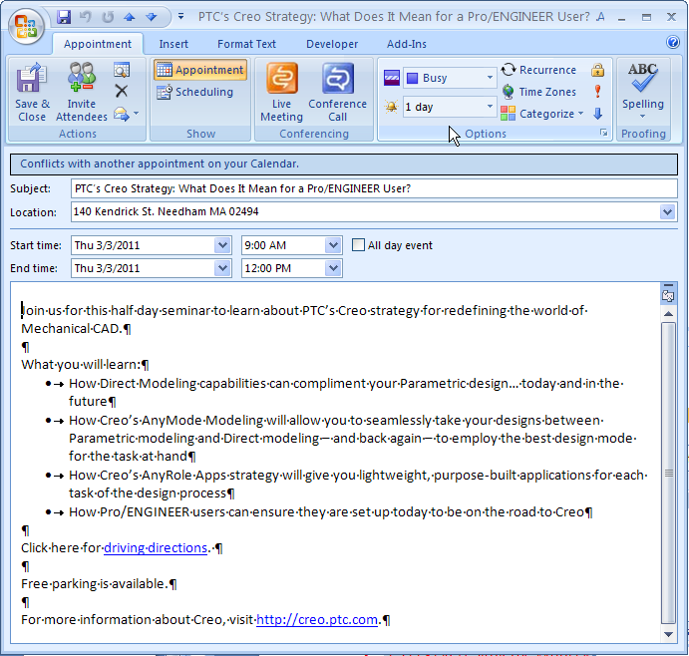
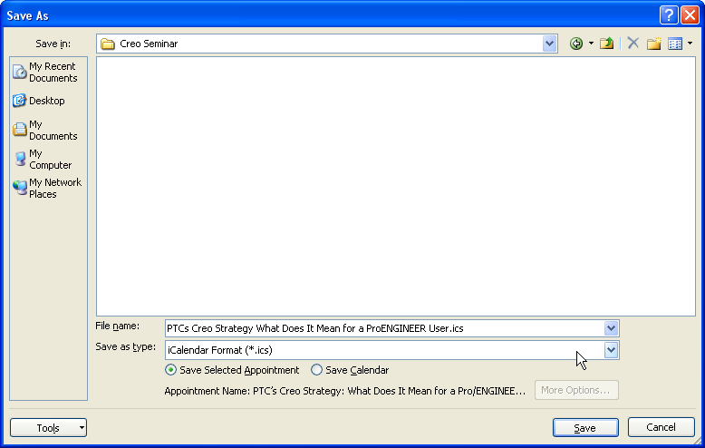
The Registration Form on your Website
Registration form should do the following:
Brief copy to promote the seminar topic, date, & time
Capture registration information for you to manage
Ask registrants to pre-submit questions on the form
Send an automatic confirmation email to the registrant so he knows he is registered
Connect the registrant to an Outlook calendar invitation
Outlook calendar invitation should have the topic, date, time, and brief promotional copy
Link to Google Maps directions
List any parking options
A pop-up reminder set for 1 day in advance
Create it in your Outlook calendar, then save it as an ICS file.
Post that file to the web and link to it from your registration confirmation page and/or confirmation email
Use of a ICS file will improve your attendee rate and reduce no-shows

Slide 165
The Registration Form on your Website
Link to the form in all promotions:
Email blasts
E-newsletter
Website banners
Sales emails
Telemarketing/Telesales (vanity URL)
Twitter/Facebook/blog posts
Etc.
Sales: resist the urge to email marketing about contacts who have verbally committed. Failure to take all registrations through the form will make it very difficult to manage the registration list, send reminders to registrants, follow up after the seminar, etc.

Slide 166
The Invitation
Writing a good Seminar Invitation
Sell the offer, not the product
Convey the value of attending
What will they gain from attending?
From whom will they learn it?
Remove reasons for hesitation
When & where is it?
How do I get there?
Is there parking?
Will I have to skip a meal?
Is it really for me?

Slide 167

The Invitation
Writing a good Seminar Invitation
A good formula to follow:
A compelling subject line
Short opening (You’re invited…)
Seminar title, location, date, time
Register today [link]
What you will learn (3 bullets)
Presenter bios
Who should attend
Register today [link]

Slide 168
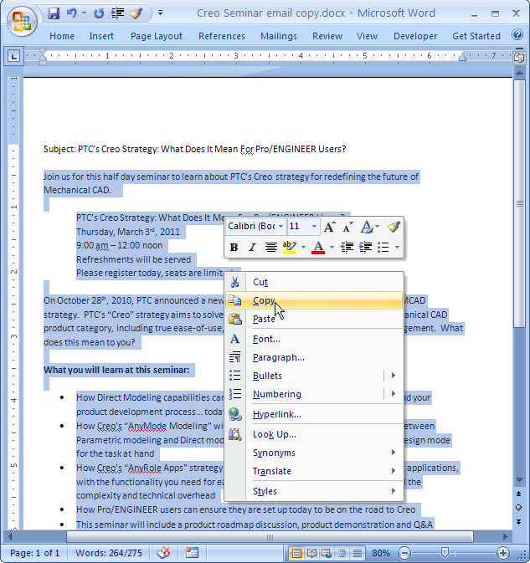
The Invitation
Email Blast using SharedVue
Compose and format your email in MS Word. Print a hard copy.

Slide 169

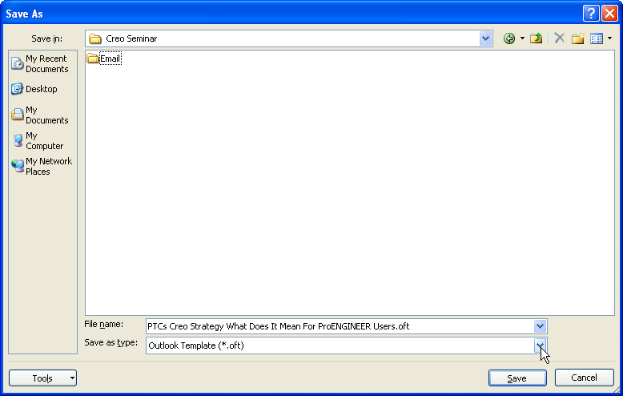
The Invitation
OFT Email
Perfect for sales enablement, one-on-one emails from a sales rep to a prospect or customer
How to create one:
Compose and format your email using Outlook’s formatting tools
Add hyperlinks to registration form
Delete your signature from the bottom
Click “File > Save As” and select the “Outlook Template (*.oft)” file type and save it to your desktop.
Attach the OFT file to an email and send it to your sales people.
When they double-click the extension it will load as an email from them, perfectly formatted and hyperlinked, ready for them to enter an email address and click “send.”

Slide 170
Agenda
Set Your Objectives & Strategies
Planning The Date, Location, Topic & Time
Marketing & Sales Coordination
Marketing Execution: Registration Form & Invitation
Seminar Presentation
Day of the Event Logistics
After the Event Follow-Through
Resources

Slide 171
The Seminar Presentation
Shift your perspective: It’s not about what you want to sell, it’s about what your sales prospect wants to learn
Customer pain points and questions
Business solutions
Benefits
PTC Presentations are available:
Marketing page of the PTC Partner Portal: “Seminar Presentations”
Creo Seminar-In-A-Box in the Creo Marketing Toolkit
Tech Sales page of the PTC Partner Portal: “Demo Library”
Line up technical resources ASAP
Tech Sales page of the Partner Portal: “Standard Demo Request Form”
3rd Party Validation
Customer (PTC Performance Partner)
Analyst
Editor for a local publication
Trade association rep
Professor from a local university
End with…
A next step in the sales engagement (PDPA)
A special offer (TLO)

Slide 172
Agenda
Set Your Objectives & Strategies
Planning The Date, Location, Topic & Time
Marketing & Sales Coordination
Marketing Execution: Registration Form & Invitation
Seminar Presentation
Day of the Event Logistics
After the Event Follow-Through
Resources

Slide 173
The Day of the Event Logistics
Registration Desk
Have it staffed before the seminar and during breaks
Registration list on hand (keep track of who attends and who does not)
Preprinted name badges (include some blank badges & a marker for any unregistered walk-ins or messed up names/titles)
Handouts:
Agenda
Print-out of the presentation deck
Product collateral
Business cards of sales staff
Satisfaction Survey (final question should be open-ended, a chance for them to ask questions or express their needs)
Flyer for special offer
Have emergency contact info on hand for:
All presenters and event staff
Facilities staff
A/V supplier
Caterer

Slide 174
The Day of the Event Logistics
Catering
Be sure to have coffee, water, juice, danishes, fresh fruit, etc.
Note: be sure to highlight the fact that refreshments will be served on your reminder email/phone campaign – it will reduce the no-show rate
Door prize(s)
Include a small gift for every attendee (a t-shirt, a nice pen with logo, a memory stick with a logo)
Perhaps raffle a larger prize for one lucky winner (an iPad or other gadget, a free license of software). Conduct the drawing at the end of the event.
Tip: Reach out to hardware software partners who might donate a door prize in exchange for a brief sponsor message
Note: be sure to highlight your door prize on your reminder email/phone campaign – it will reduce the no-show rate

Slide 175
Agenda
Set Your Objectives & Strategies
Planning The Date, Location, Topic & Time
Marketing & Sales Coordination
Marketing Execution: Registration Form & Invitation
Seminar Presentation
Day of the Event Logistics
After the Event Follow-Through
Resources

Slide 176
After the Event Follow-Through
“Thank you” email for attendees
“Sorry we missed you” email for no-shows (offer to come to their office to present the content)
Follow up emails should have some engagement:
Related white paper
Special offer
Write up the highlights of the event for your newsletter or blog
Update your marketing database with any new/changed contacts

Slide 177
Agenda
Set Your Objectives & Strategies
Planning The Date, Location, Topic & Time
Marketing & Sales Coordination
Marketing Execution: Registration Form & Invitation
Seminar Presentation
Day of the Event Logistics
After the Event Follow-Through
Resources

Slide 178
Basic Information Medicare Supplements
How can I (the Client Agent) HELP the Client

Slide 179
So many clients need a trusted Agent
Is the client Turning 65 in the next year? Or been on Disability for 24 months?
Is the Client still working and and on group plan( but still ask question)
Medicare Part A is only for Hospital
So what is Part B?
What clients need to do about Part D?
If the client ask what is Part C?
Notes:
You usually don’t pay a monthly premium for Part A coverage if you or your spouse paid Medicare taxes while working. This is sometimes called premium-free Part A. If you aren’t eligible for premium-free Part A, you may be able to buy Part A.
In most cases, if you choose to buy Part A, you must also have Part B and pay monthly premiums for both.
People who have to buy Part A will pay up to $413 each month in 2017.
Part A deductible $1316
Part B deductible $183

Slide 180
A lot of questions Supplement or Advantage Plan
All the plans are State and sometimes certain counties
I do not take Medications why I did drug plan?
Could only keep Medicare only?
Does everyone get Part A FREE?
Does everyone pay the same for part B per month? And how do I pay part B?
When can I buy a Medicare Supplement?

Slide 181
Yes we all should help our clients
How can I help?
WWW.CAPMAR.COM
Agent Portal
Go the Senior Market Training and log in
Login name is = user
Password is = password
Watch YouTube videos

Slide 182
Great book to have Medicare and You
Each State have there own Medicare and You book ( if you order one from Medicare for your state)
Like going over page 17 with clients( I do not care if they been on MEDICARE for years.
Page 27 thru 29,
Medigap plans page 82
How does Medigap work with Medicare Advantage plans?

Slide 183
Capmar can help you
Get the best Medigap companies in your state
Why should you ?
Should you partner with another agent ?
ALWAYS do the right my client and family

Slide 184
Question
Www.medicare.gov
/pubs/pdf/10050-Medicare-and-You.pdf

