Slide 1
PLAN FOR LIFE with AMERICAN NATIONAL
Brooke T Malley, CLU®,CHFC®, National Sales Manager

Slide 2
Why Consider Signature GUL?

Slide 3
The Power of the Pig
Term vs Signature GUL
-the less “expensive” option.
-Limited options.
-ABRs available?
-Signature GUL- “Power of the Pig”.
- “Crack the Bank”
-ABRs

Slide 4
College Planning
38 Y/O Female
Twin Daughters-1 years old
Insurance Need 1 Million
Buy two 500k GUL
~$2,400/yr. ea. ($200/mo.)
~$4,800/yr. total ($400/mo.)

Slide 5
College Planning
Cash Out Options
Year 15-(least Likely to use, but available)
$23,252 of cash (65% of premiums paid) ea. Total $46,504
Year 20-(possible)
$47,901 of cash (100% of premiums paid) ea. $95,802 total
Year 25(also possible)
$59,876 of cash (100% of premiums paid) ea. $119,752 total.
…But why did I buy Two instead of One? What are my other options?
Take the cash from one and pay off the other one with lump sum
Take cash from one, buy retirement vehicle (maybe SPIA, hey ANICO has great SPIAs) and keep other.
…many options by purchasing multiple policies.

Slide 6
Insuring Your Insurance
Fully funded IUL for Retirement.
Has ABRs, but do you want to risk your retirement assets in the event of a Critical/Chronic Illness.
Why not Insure your Insurance?
Purchase Signature GUL as complimentary policy
If Critical/Chronic Illness, can use the SGUL for claim
If no claim, year 15, 20, 25 can cash out and “dump in” lump sum to IUL or pay off other obligation.

Slide 7
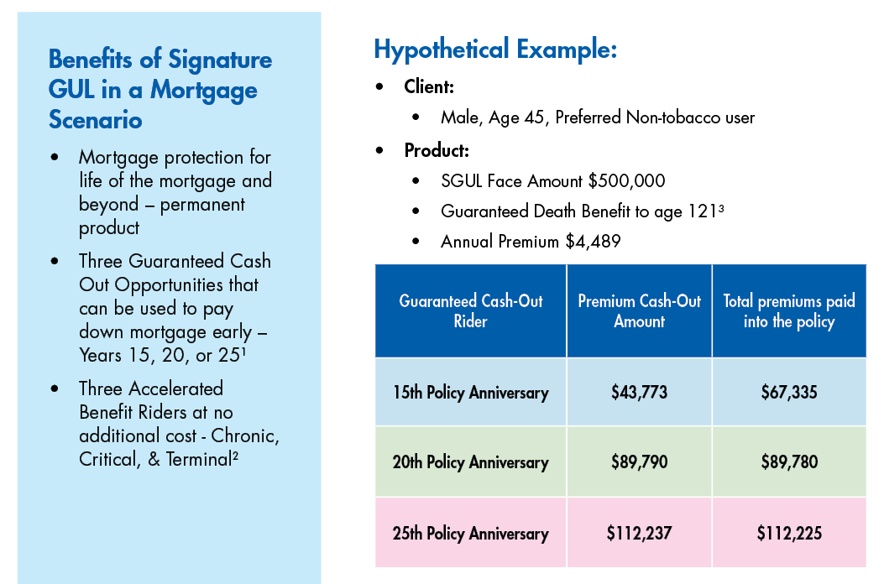
Mortgage Protection
For Agent Use Only; Not for Distribution or Use With Consumers.

Slide 8
Mortgage Protection
Benefits of Using the Cash-Out Rider as a Lump Sum Pay Down: |  |  | Benefits of Incremental Pay Down
Year 15: Lump sum principal payment of $43,773 Pay off Mortgage 30 months early Total Interest Paid: $378,187.76 (savings of $33,845.80) | Year 20: Lump sum principal payment of $89,790 Pay off Mortgage 51 months early Total Interest Paid: $378,918.55 (savings of $33,115.01) Age 65, close to retirement- free up $2,533.43 per month | Year 25: Lump sum principal payment of $112,237 Pay off Mortgage 48 months early Total Interest Paid: $401,527.30 (savings of $10,506.26) | Pay Down Early – Extra Principal Payment(s) - Pay One Extra Payment (monthly) Pay additional $212 Monthly Pay off Mortgage 53 months early Total Interest Paid: $342,561.52 (savings of $69,472.04)
For Agent Use Only; Not for Distribution or Use With Consumers.
Policy is terminated when utilizing Cash-Out Rider – no life coverage.

Slide 9
Divorce Planning
Jim and Mary (32 y/o) divorce.
3 kids 4, 2, 1
Jim $150k/year
Mary stay at home mom
Divorce Decree
$3,500/mo. (decreasing as each child reaches 18)
Full college tuition for all 3
$1,500/mo. alimony
Required to purchase life insurance on his life with MARY as beneficiary to ensure the above is fulfilled……..what was that amount………….

Slide 10
Divorce Planning
The Need
The Options
Total Child support obligation as long as all children remain healthy =18 years=$657,000
Total Alimony assuming Mary lives to at least age 80 and does not remarry=(at least)=$936,000
They negotiate a $1,000,000 life insurance policy to cover the need.
Term
Assuming Pref NT
$960/year
ABRs?
Limited options
GUL
$4,172/year
ABRs
Year 15-$40,679
Year 20-$83,443
Year 25-$104,304
….Wouldn't he rather have options in years 15,20, and 25 than just pay premiums to benefit his EX-WIFE if he DIES?????????????

Slide 11
Buy-Sell Agreement
Most plans funded with term.
Reviews for “new” or “old” type of term.
Consider using Signature GUL
Death Benefit Coverage
Critical/Chronic illness Coverage
Cash out in years 15/20/25 available for buy-out, debt reduction, or retirement.

Slide 12
Key Person
Bob (45) is Key employee at XYZ Manufacturing
Employer Purchases 300k Signature GUL on Bob.
DB to cover the loss of the key employee.
ABRs to cover Critical/Chronic Illness of Bob
BUT ALSO in 20 years when Bob retires, XYZ can offer Bob a nice retirement “bonus”
Or
Get their premiums back as they no longer need the coverage on Bob

Slide 13
Complete Life, Annuity, and Pension Portfolio
Annuity Solutions
Life Insurance Solutions (Individual and Simplified Issue for Worksite Marketing)
Fixed
Palladium MYG(NY too)
WealthQuest Citadel Diamond 5/7 (NY too)
Palladium Century
SPIA
Palladium SPIA (NY too)
Indexed
ANICO Strategy Indexed Annuity Plus 7/10 (NY too)
Term Insurance
ART, 10, 15, 20, 30(NY too) (SI Too)
Signature GUL(NY too) (SI too)
Executive UL (NY too) (SI too)
Signature Whole Life (NEW too)
Signature IUL(NY too)
Signature IUL+(NY too)

Slide 14
Underwriting Express

Slide 15
#1 REASON To Sell..Plan for What Matters Most!!!

